Slide 1

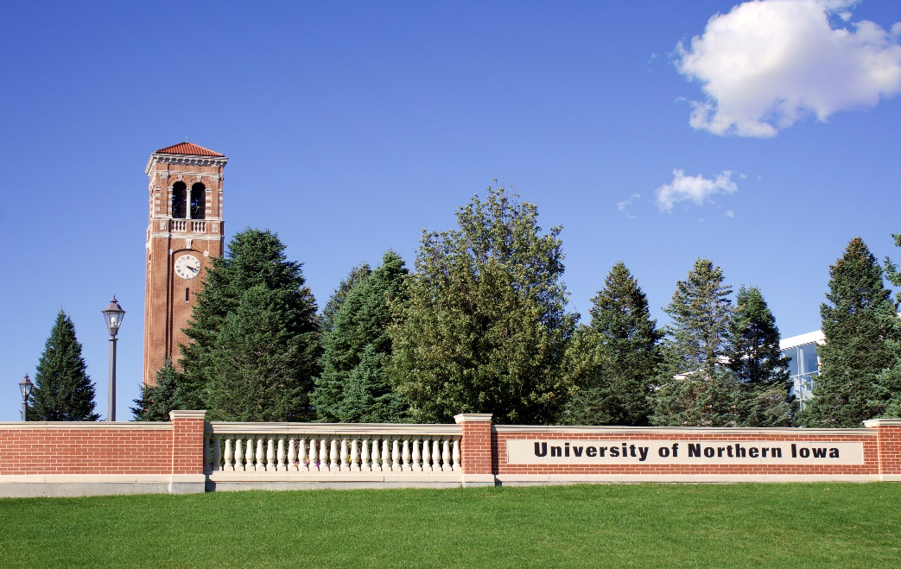
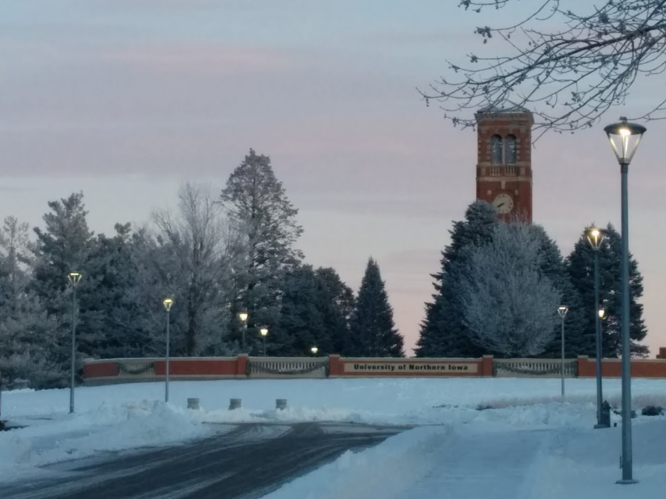
Office of Continuing and Distance Education
A Journey Through QM Course Design and Development: The Intertwined Stories of
a Faculty and an Instructional Developer
Madalina Tincu, Ed. D.
Mitchell Strauss, Ed. D.

Slide 2

Office of Continuing and Distance Education
Presentation Overview
Introductions
Online Course Development Award and Implementation of Quality Matters
Focus:
  A Story of Course Design: Faculty/Instructor
  A Story of Course Development: Instructional Developer

Slide 3

Office of Continuing and Distance Education
Online Course Development Award Process of Implementing the QM Online Course Award
Online Course Award
Pre-Course Development Instructor Preparation
Course Design and Course Development
Course Review
Course Implementation: Ongoing Support
Post-Course Development

Slide 4
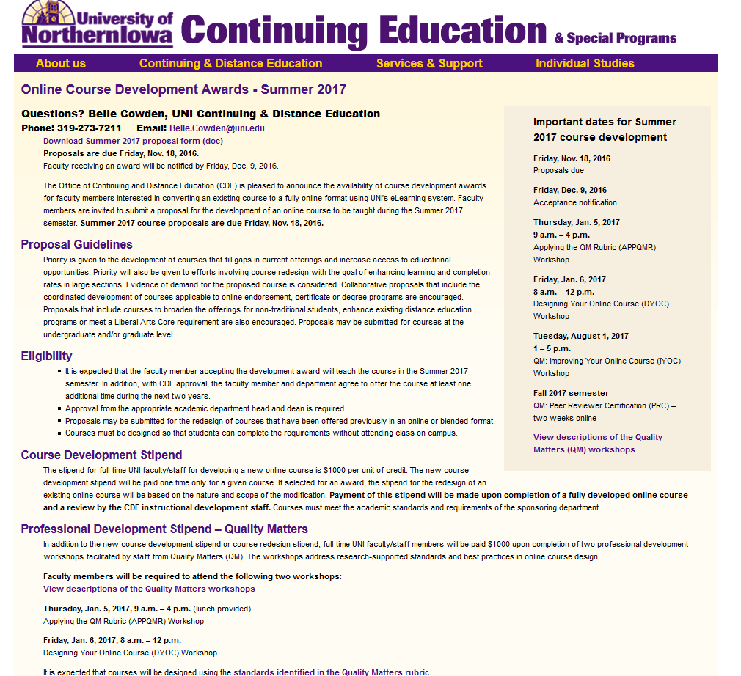
Office of Continuing and Distance Education
Online Course Award
Stipend-based awards
Notice of award availability provided on the website
Guidelines clearly stated
https://www.uni.edu/continuinged/faculty/courseproposals/online/summer16

Slide 5
Office of Continuing and Distance Education
Pre-Course Development Instructor Preparation
APPQMR and DYOC, sessions with QM facilitators
Individual new developments assigned to IDs
Personalized assistance
Ongoing communication and support

Slide 6
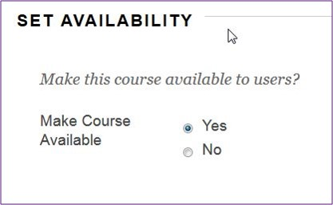
Office of Continuing and Distance Education
Course Design and Course Development
Course Review: QM Rubric
Course Implementation: Ongoing Evaluation and Support
Post-Course Development

Slide 7
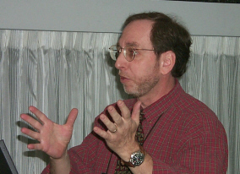
Office of Continuing and Distance Education
I was dubious about Distance Learning…
For 35 years I taught face to face…
To use fashion terminology, I thought online was fad…
My opinion’s changed now…
Face to face all the way!

Slide 8
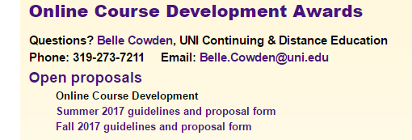
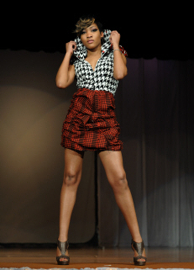
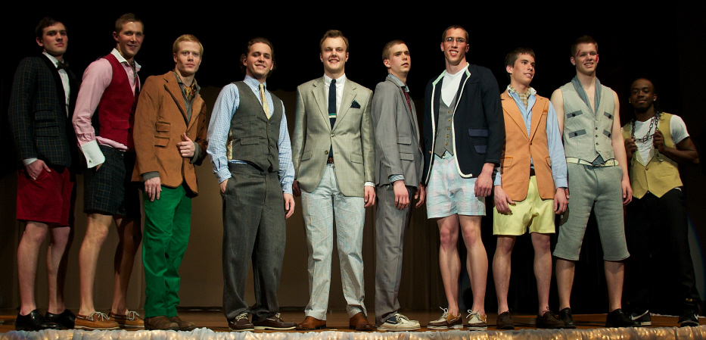
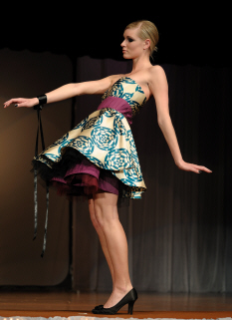
Office of Continuing and Distance Education
Why did I enter this milieu?
It was happening all around me in my unit…
I thought this might be a great way to extend the impact of my fashion program…
The UNI incentive program was hard to ignore…

Slide 9
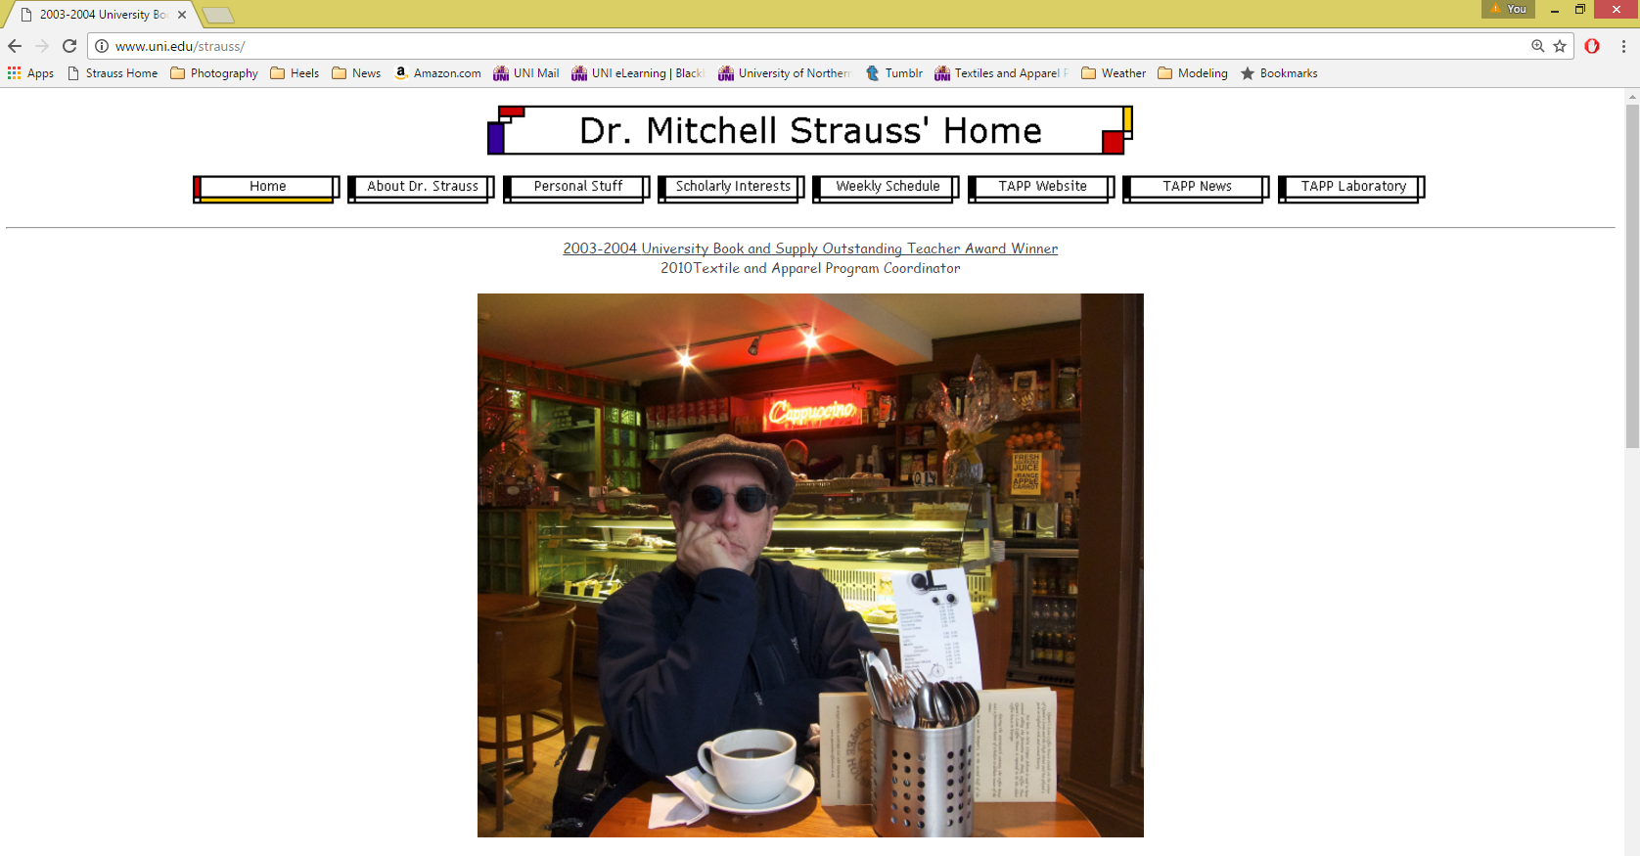
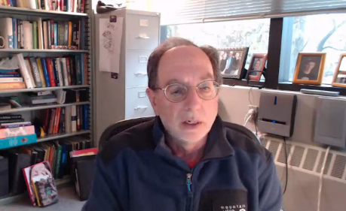
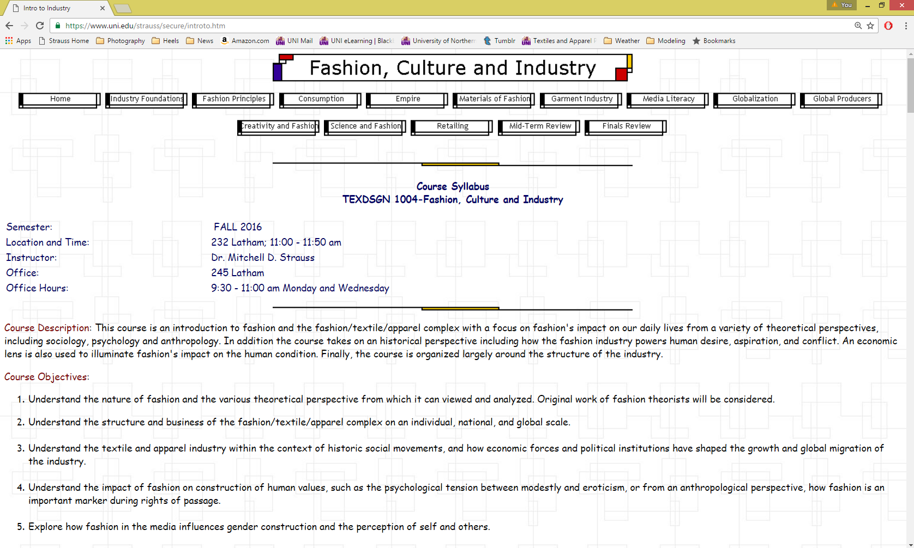
Office of Continuing and Distance Education
I thought it would be a snap to convert the way I taught online!
I’d been using HTML to augment my teaching for 18 years.
I just thought I could add a talking head!
But I was quickly disabused with my QM training…
QM has much higher aspirations!

Slide 10
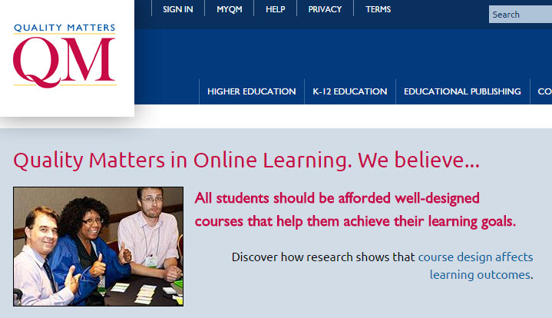
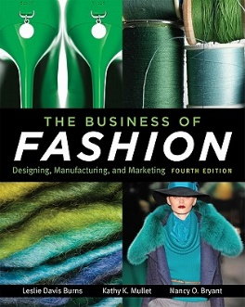
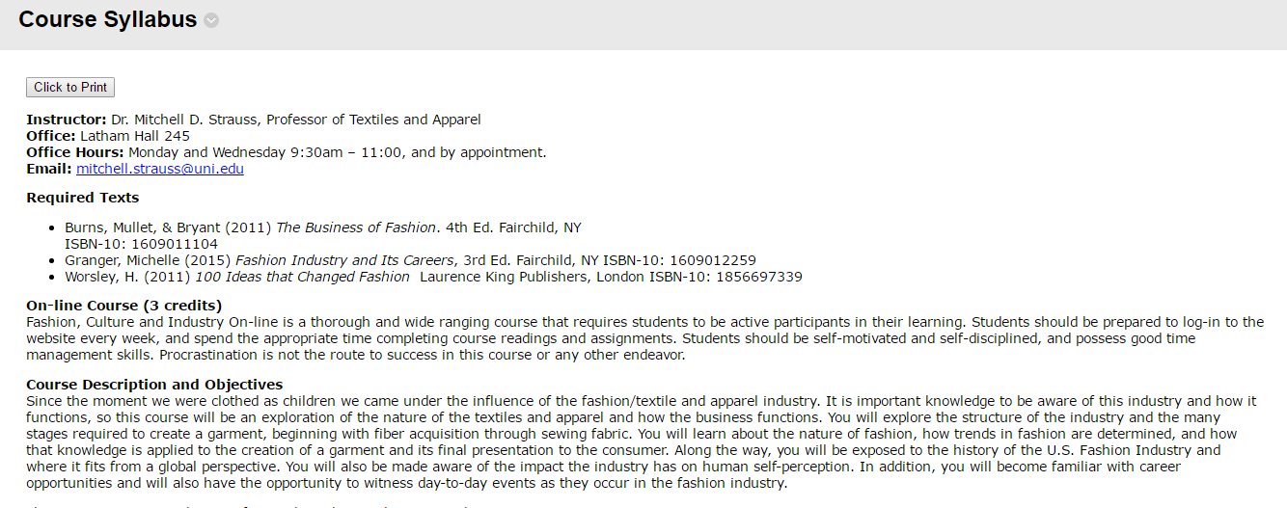


Office of Continuing and Distance Education
Half way through the QM training, I realized I had to rebuild from scratch!
That is, of course, if I wanted to build a first class educational experience…
Honestly, the financial incentive was a big motivator too…
So… I went to work rebuilding using QM as my guide…

Slide 11
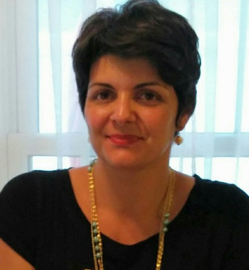
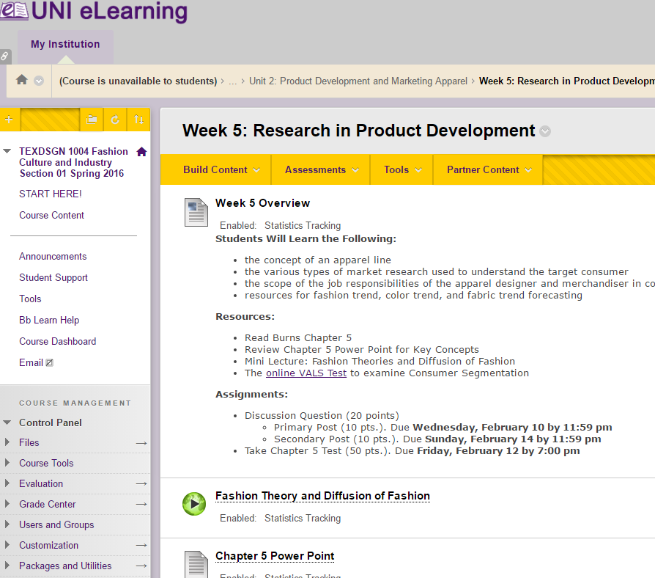
Office of Continuing and Distance Education
To scale up from concept to actual course is a big deal!
That where the UNI program
was really great!
Every step of the way I had
the help and guidance of
a Madalina as the course
took form…
All the nuances of our eLearning
platform were brought to play
with Madalina’s expertise…
QM goals were always in the
framework of development…

Slide 12
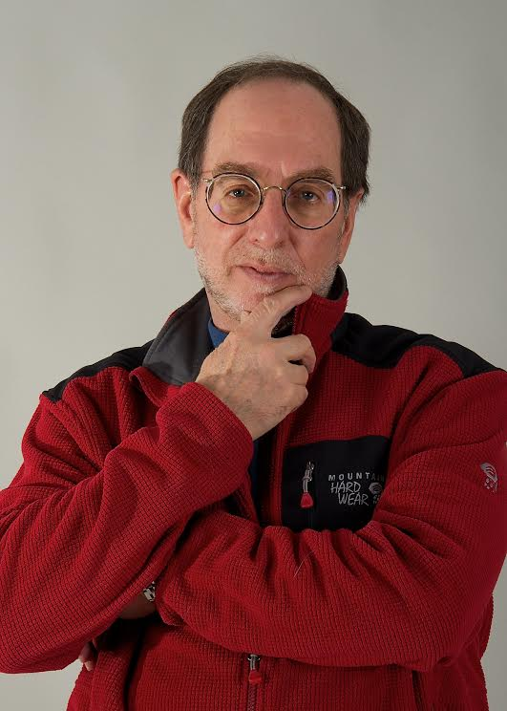
Office of Continuing and Distance Education
So… what do I think?
A preponderance of the effort is front-loaded…
I was freed from personal content delivery and could focus on student learning!
I learned a well constructed online course was an organized, self-directed program of knowledge acquisition…
A free-floating virtual community can be developed if the course is executed properly…
Students seemed less constrained in sharing their thoughts…
I use what I learned in hybrid instruction too…
Still… I do miss face to face interactions…

Slide 13

Office of Continuing and Distance Education
Discussion and Questions
Design - Review - Develop - Self-study - Peer Evaluation
Continuous improvement – IYOC and PRC
QM Rubric/standards
How does the development process support the QM alignment and quality of online teaching and learning considering the instructional workmanship shared by faculty and IDs?

Slide 14

Office of Continuing and Distance Education
Thank you!
Mitchell Strauss, Ed. D.
mitchell.strauss@uni.edu
Madalina Tincu, Ed. D.
madalina.tincu@uni.edu
Additional Email:
ContinuingEd@uni.edu
Phone:
1-800-772-1746
https://www.uni.edu/continuinged/distance

