Slide 1
Use QM CPE Rubric to Guide the Design of a MOOC Developmental Course
Yaping Gao, EDD District Director, Instructional Design
Notes:
Self-introduction

Slide 2
About Broward College
Headquarters in Ft. Lauderdale, FL
Multiple campuses & county centers
Various international affiliates
68,000+ students annually (28,000 FTE)
18 Online Programs & Certificates (since 2000)
QM subscriber since 2008
Broward College Online since January 2013
Notes:
About BC

Slide 3
Florida Legislative Change
Florida Senate Bill – SB 1720 http://www.flsenate.gov/Committees/BillSummaries/2013/html/501
Students who are not required to be tested or to enroll in developmental education may request assessment and may enroll in developmental education if they wish. The bill requires:
By March 1, 2014, Florida College System institutions to submit developmental education plans to the Chancellor of the Florida College System for implementation beginning no later than Fall 2014;
Each Florida College System institution and the Florida College System Chancellor to submit annual accountability reports to the state beginning in 2015.
Notes:
Florida legislation changes about developmental education.
Two groups of students will not be required to take developmental courses:
Students who entered 9th grade during 2003-2004 = graduated in 2007.
These on active military duties

Slide 4
Is MOOC the Solution?
Groundwork
0
Virtually No Budget
Contract with Canvas as LMS (free)
FL PERT Competencies (Postsecondary Education Readiness Test)
Reading, Writing & Math
Faculty Developers (2 SMEs for each area)
Instructional Design Team (3 Senior IDs)
Instructor Team (3 Online Instructors)
Notes:
Assemble teams, secure LMS for MOOC, identify developer and instructional support and instructor teams

Slide 5
Yes, MOOC It Is!
Project Timeline 0
0
Jan. – Feb. Assemble teams
Mar. – Apr. Content development
May – Review and fine-tune
June 3rd – Launch 1st session (4 weeks)
July 15th – Launch 2nd session (6 weeks)
Sept. 23 – Launch 3rd session (12 weeks)
Notes:
Timeline

Slide 6
College Foundations: Reading, Writing & Math
Course Design
0
QM CPE Rubric (Continuing & Professional Education)
Canvas Network Course Design Checklist: Initial Review
Canvas Network Checklist: Before Course Launch
Notes:
QM CPE Rubric and Canvas checklists used during MOOC development; more in later slides.

Slide 7
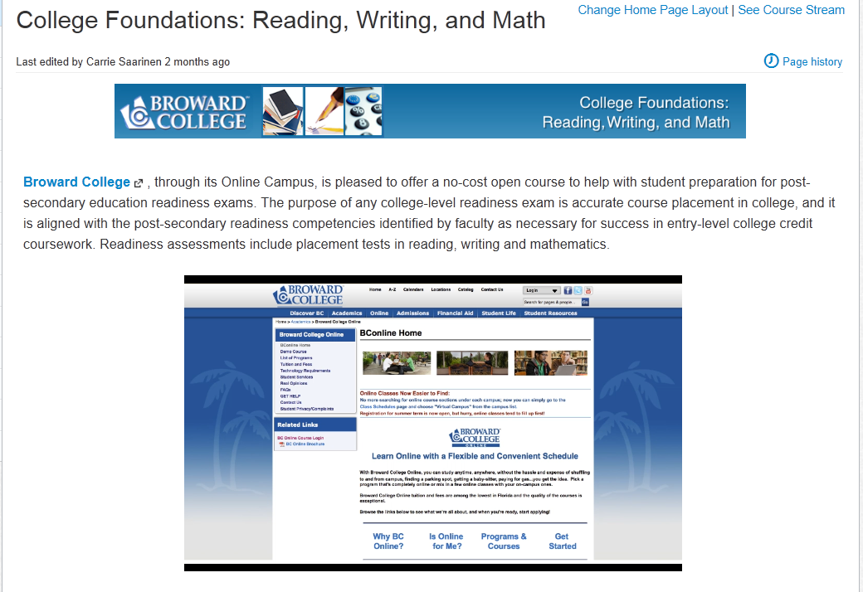
College Foundations: Reading, Writing & Math
Notes:
Landing page (course homepage) with video to introduce Broward College and the purpose and structure of the MOOC.

Slide 8
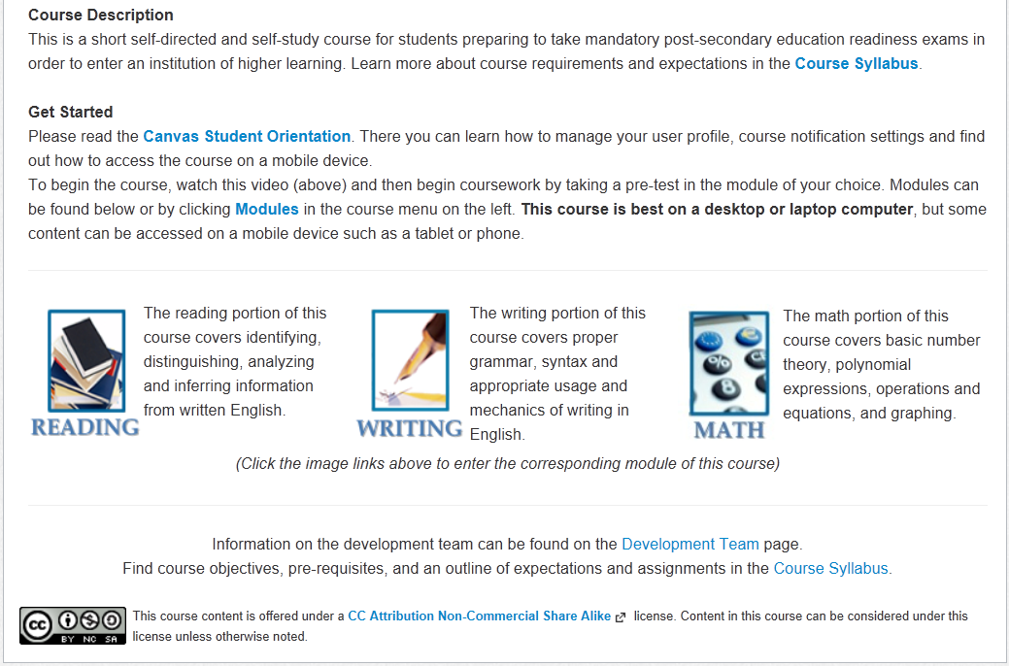
College Foundations: Reading, Writing & Math
Notes:
2nd part of the landing page (course homepage) with icon/link to each module.

Slide 9
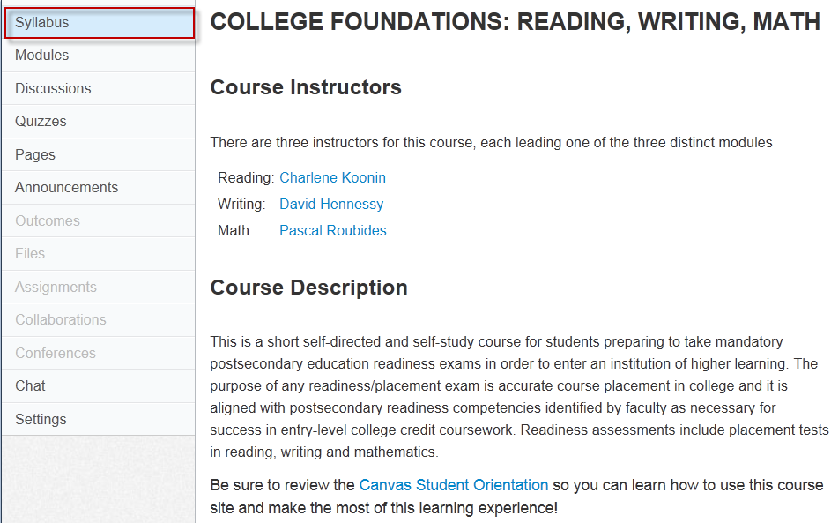
College Foundations: Reading, Writing & Math
Notes:
Syllabus

Slide 10
College Foundations: Reading, Writing & Math
Notes:
Syllabus

Slide 11
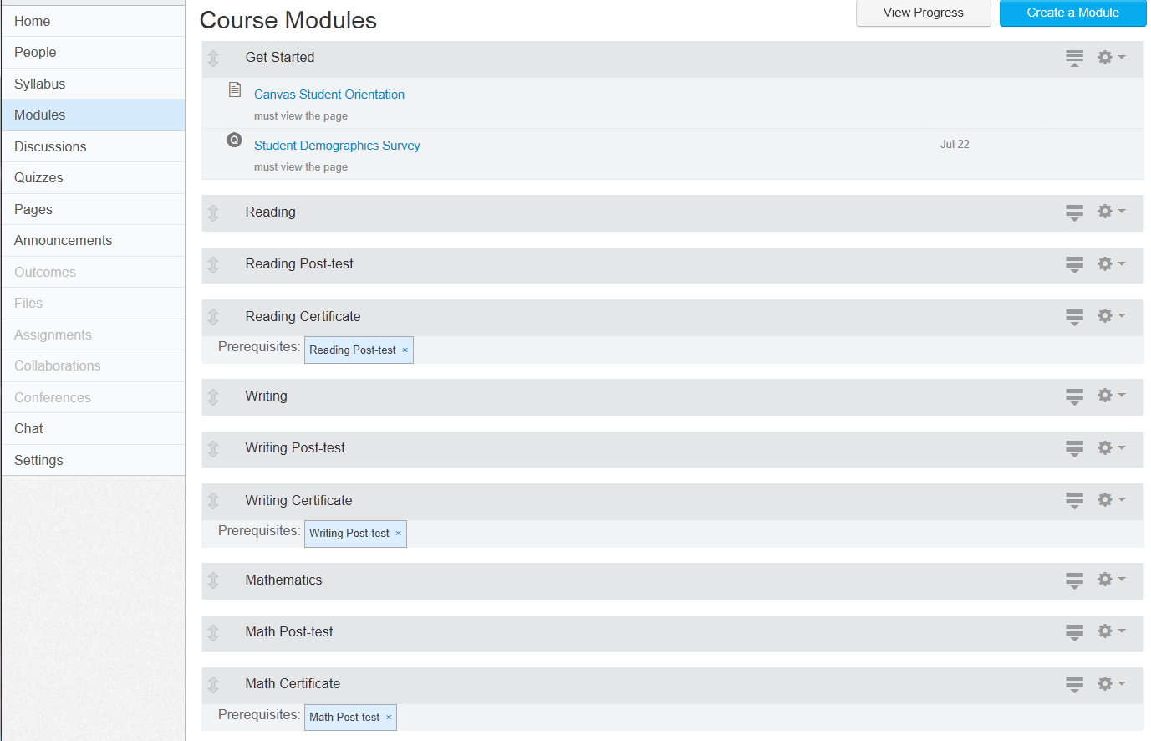
College Foundations: Reading, Writing & Math
Notes:
Layout of three modules – pre-test is within the module content

Slide 12
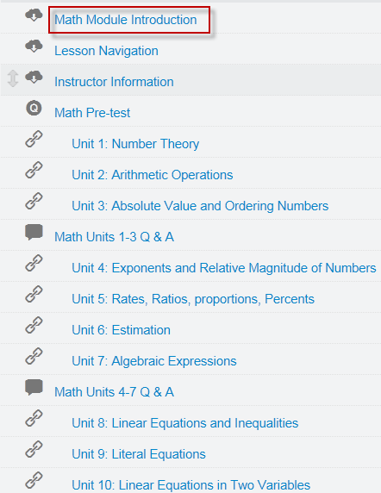
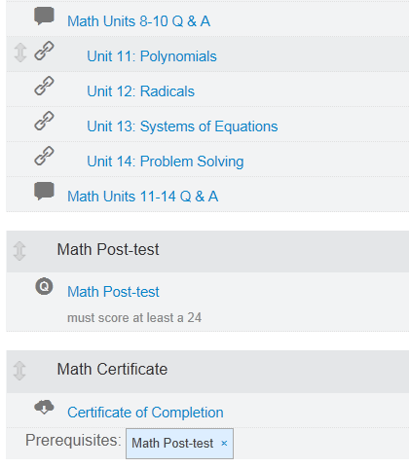
College Foundations: Reading, Writing & Math
Notes:
Math module as an example

Slide 13
College Foundations: Reading, Writing & Math
Notes:
Video introduction to Math module.

Slide 14
College Foundations: Reading, Writing & Math
Notes:
Video introduction on how to navigate the lessons (all content are developed with SoftChalk).

Slide 15
College Foundations: Reading, Writing & Math
Notes:
Introduction to the instructor who facilitates the Math module.

Slide 16
College Foundations: Reading, Writing & Math
Animation created by Math faculty, Broward College
Notes:
Sample content page with animation produced by BC Math faculty. Only screenshot.

Slide 17
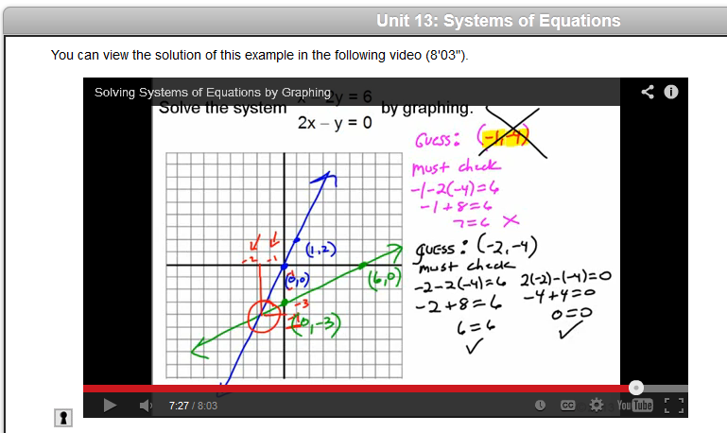
College Foundations: Reading, Writing & Math
Video created by Math Faculty, Broward College
Notes:
Sample content page with video illustration produced by BC Math faculty. Only screenshot.

Slide 18
College Foundations: Reading, Writing & Math
http://www.youtube.com/watch?v=XQ7aNAxZ0s0 – YouTube video by yaymath.org
Notes:
http://www.youtube.com/watch?v=XQ7aNAxZ0s0
YouTube video illustration by yaymath.org.
Only screenshot.

Slide 19
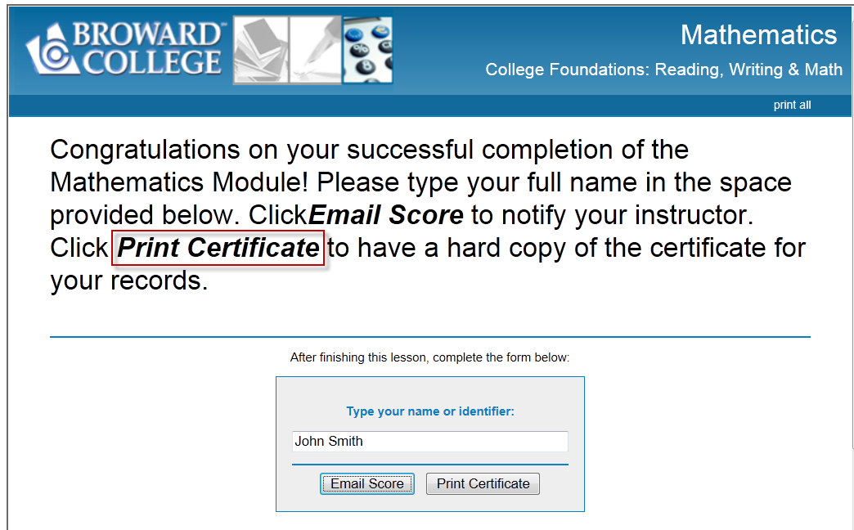
College Foundations: Reading, Writing & Math
Notes:
If students get 24 questions correct out of 30 for the Post-Test (80% or higher), they will be able to Print Certificate.

Slide 20
College Foundations: Reading, Writing & Math
QM CPE Rubric as Design Guide
0
Majority standards apply
Less emphasis on certain standards:
1.4 institutional policies related
1.5 prerequisite (developmental)
1.6 minimal technical skills
1.8 learner self-introduction
Notes:
Lesson emphasis on certain QM CPE standards.

Slide 21
College Foundations: Reading, Writing & Math
QM CPE Rubric as Design Guide
- Continued -
0
Less emphasis on certain standards:
5.4 required for learner interaction
7.2 institutional accessibility policies
7.3 support services & resources
8.1 accessible technology & accommodations (Canvas)
Notes:
Lesson emphasis on certain QM CPE standards.

Slide 22
Ready to Launch!
canvas.net
Free
Anyone can register
Only requires email
Notes:
http://www.canvas.net for registration.

Slide 23
College Foundations: Reading, Writing & Math
1st Session, June 3 – June 30, 2013 (4 weeks)
996 student accounts
281 completed demographics survey
Time spent: 1 hour - 10 hours+
174 Female / 107 Male
118 plan to attend Broward College
124 live in Broward County
Notes:
Student demographics.

Slide 24
College Foundations: Reading, Writing & Math
1st Session, June 3 – June 30, 2013 (4 weeks)
Notes:
Students demographics - nationality

Slide 25
College Foundations: Reading, Writing & Math
2nd Session, July – Aug. 24, 2013 (6 weeks) 1673 students
Notes:
Students demographics - nationality

Slide 26
College Foundations: Reading, Writing & Math
Instructor Impressions of Students
Group 1: no-interest
Group 2: interested in certain sections
Group 3: serious and diligent
Notes:
Group 1: registered, no-interest, no show, or no participation or completion
Group 2: interested in gaining knowledge from certain sections; no interaction or participation in discussion unless have questions
Group 3: serious and diligent, completion of everything; ask questions, participation in all

Slide 27
College Foundations: Reading, Writing & Math
Lessons Learned 0
It takes a village but can be done!
Self-motivation = Success
Technical issues
Instructor presence
Course design matters
Majority QM Standards apply
Notes:
Lessons learned

Slide 28
FL State MOOC
Florida’s Statewide Developmental Education MOOC What’s Ahead
January 2013, FL State RFP for a state funded ($300,000) developmental course to be shared by all Florida State College System Institutions
Broward College won!
College Readiness through Game-Based Learning
Notes:
Broward College won Florida state grant to develop a developmental course.

Slide 29
FL State MOOC
Florida’s Statewide Developmental Education MOOC What’s Ahead
January 2014 – December 2015
Hire Project Manager
Game-based content development (outsourcing)
Modular approach with pre-assessments
3 separate MOOCs: Reading/Writing/Math
Notes:
FL state MOOC

Slide 30
Credits
Design & Support Team Lizette Foley Teri Goodchild Sharon Rifkin Nova Lishon-Savarino Instructional Team Reading: Charlene Koonin Writing: David Hennessy Math: Pascal Roubides | Reading SME Team Jennifer Solley Stacey Stember Writing SME Team Ana Cowo James Martin Math SME Team Jody Harris Pascal Roubides
Notes:
Without the dedication and the hard work of all the teams involved, nothing could have happened.

Slide 31
Contact Information
Yaping Gao ygao@broward.edu
Questions?
Notes:
Contact info.

