Slide 1


Lessons of the Pandemic:
What the CHLOE 5 Survey tells us about the future of online learning
Ron Legon, Ph.D., Executive Director Emeritus, QM, and Co-Director, CHLOE
Bethany Simunich, Ph.D., Director of Research and Innovation, QM

Slide 2
POLL: WHAT IS YOUR PRIMARY ROLE AT YOUR INSTITUTION?
Chief Online Office/Administrative leader of online learning
Other Administrator, not affiliated with online learning (President, Provost, Dean, etc.)
Full-Time Faculty
Part-Time Faculty
Instructional designer, educational technologist, etc.
Faculty developer, CTL staff, etc.
IT or technology staff
Other

Slide 3
CHLOE context and focus
Perspective of the chief online officer (COO)
Distributed in May 2020
Questions related to preparedness for and success of remote pivot
Included questions on plans for Fall
308 institutions represented

Slide 4
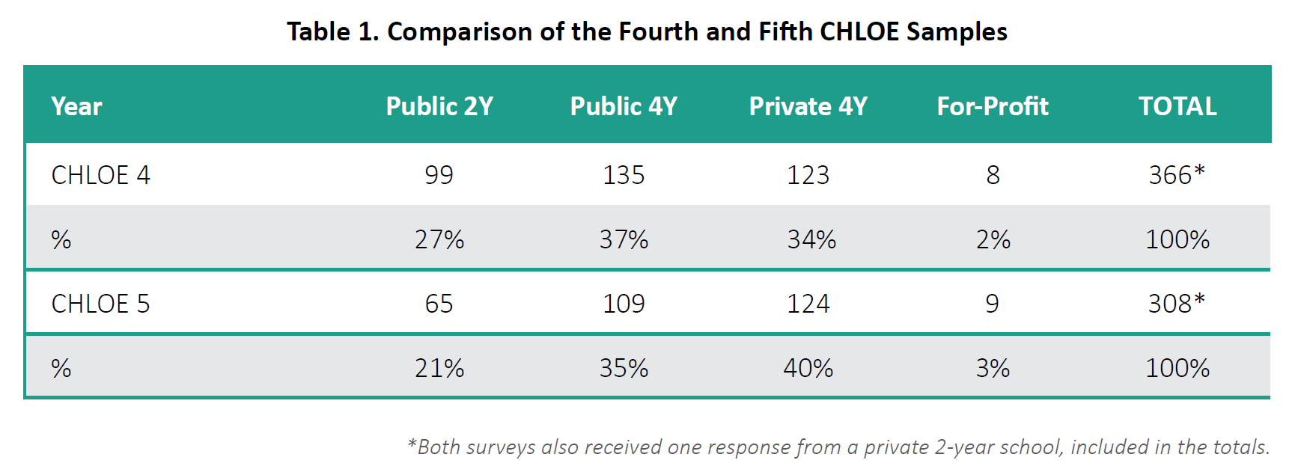
Chloe 5: sample of chief online officers from 308 institutions

Slide 5

MAJOR CHALLENGES DURING
THE PIVOT TO REMOTE LEARNING

Slide 6
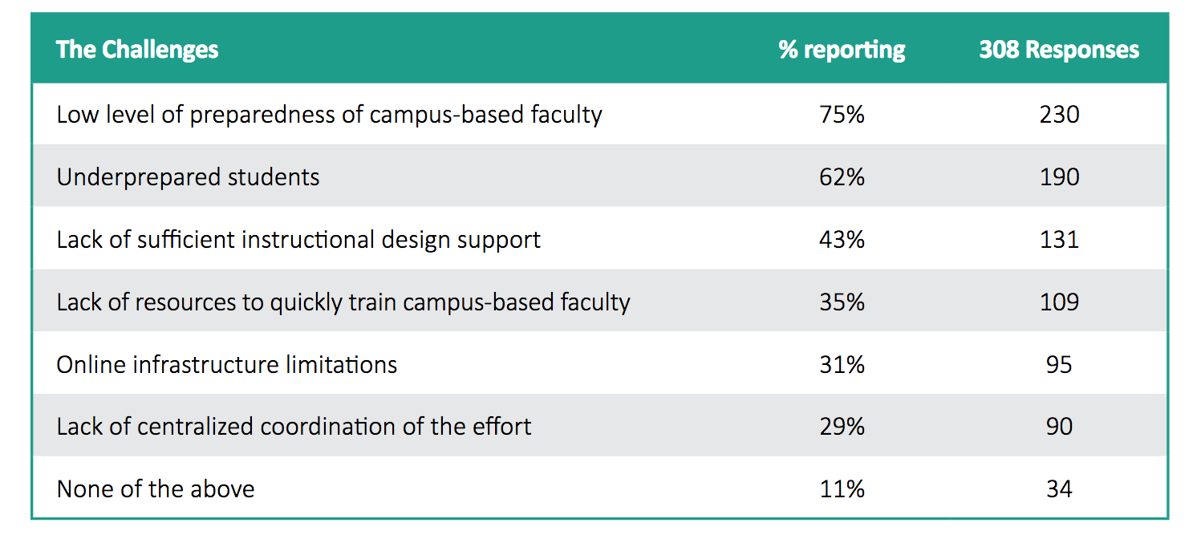
Major Challenges:
Lack of preparedness, resources, and coordination

Slide 7
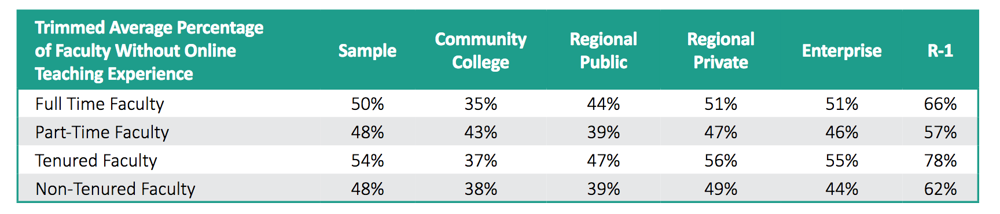
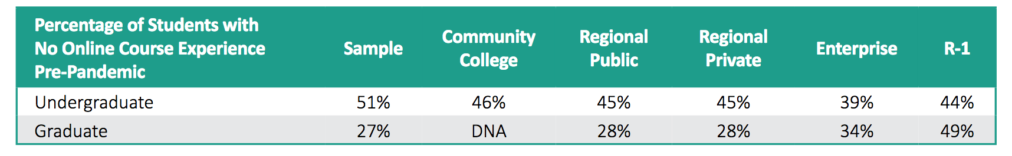
Campus Faculty & students: UNFAMILIAR AND UNPREPARED
FOR ONLINE LEARNING

Slide 8
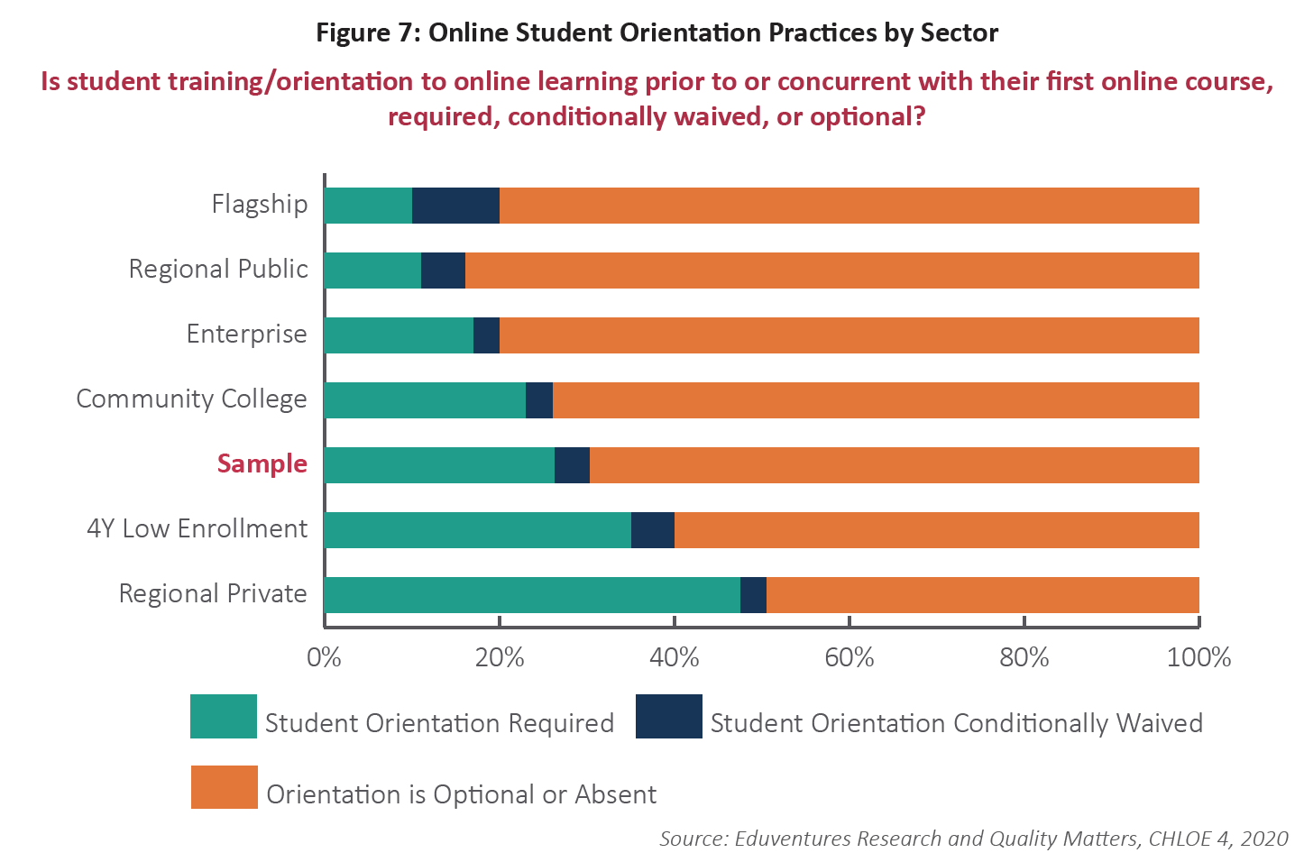
STUDENT ORIENTATION LACKING IN MAJORITY OF INSTITUTIONS

Slide 9
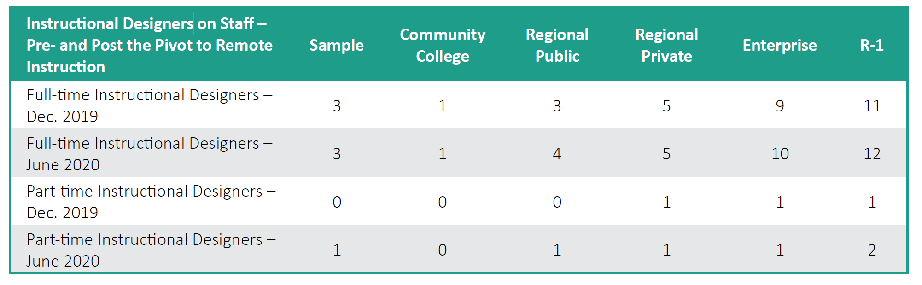
HOW MUCH HELP CAN A FEW instructional designers PROVIDE?
Average Number of Instructional Design Staff
December 2019 vs. June 2020

Slide 10
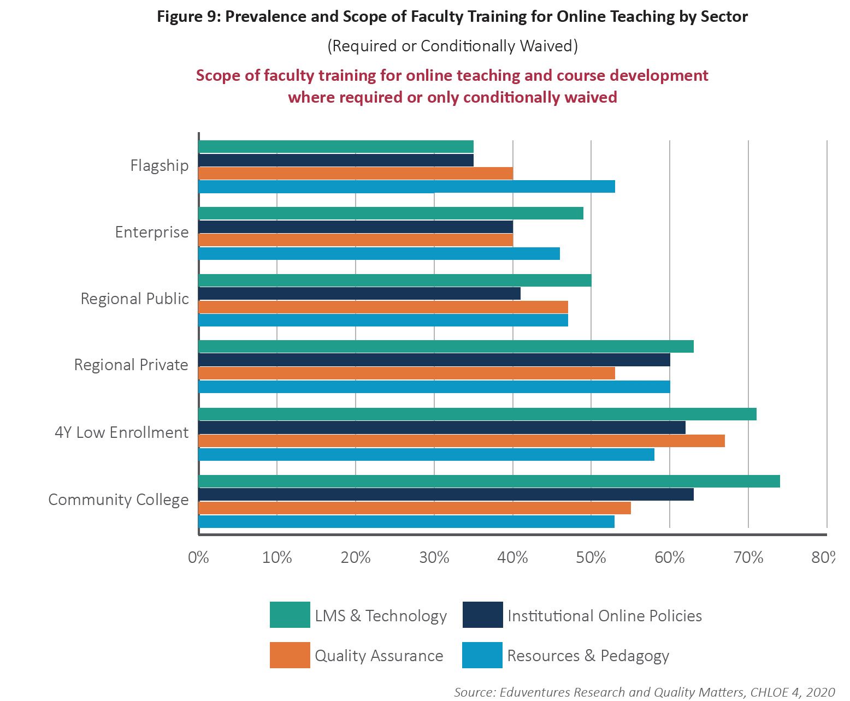
FACULTY TRAINING ONLY FOR THOSE INTENDING TO TEACH ONLINE

Slide 11
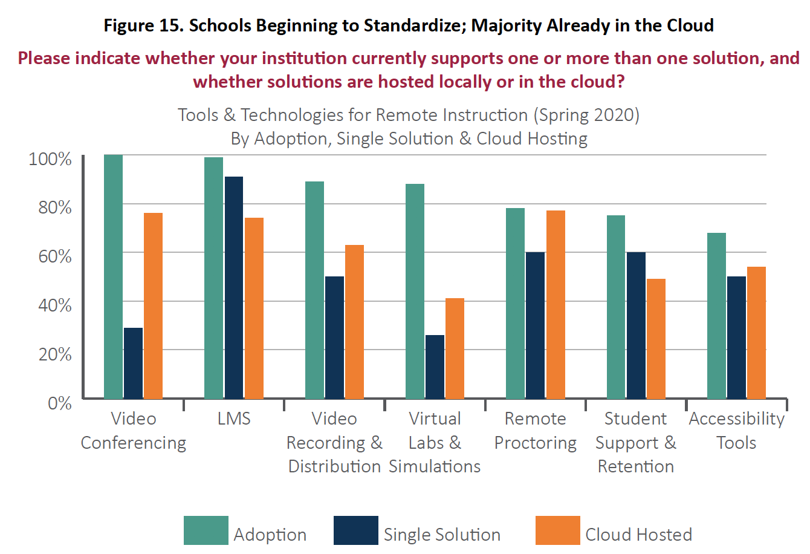
Relative Maturity of tools for online learning

Slide 12
POLL: WHAT SPRING CHALLENGE IS YOUR BIGGEST CHALLENGE THIS FALL?
Faculty unprepared/underprepared to teach remotely or online
Lack of student orientation or student support for online learning success
The Digital Divide
Lack the proper technology tools for good online learning
Courses not designed for online/course quality is an issue
Other

Slide 13
Faculty AND STUDENT POST-PIVOT REACTIONS TOWARD ONLINE LEARNING

Slide 14
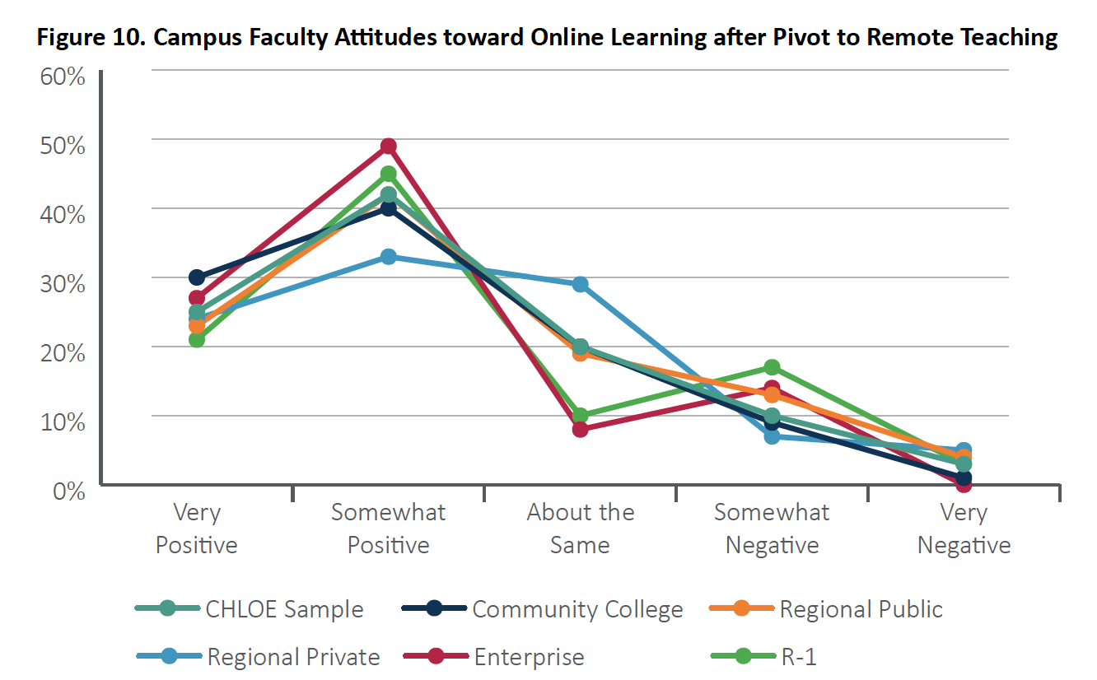
COO Judgment of post-pivot campus faculty Attitude toward online Learning

Slide 15
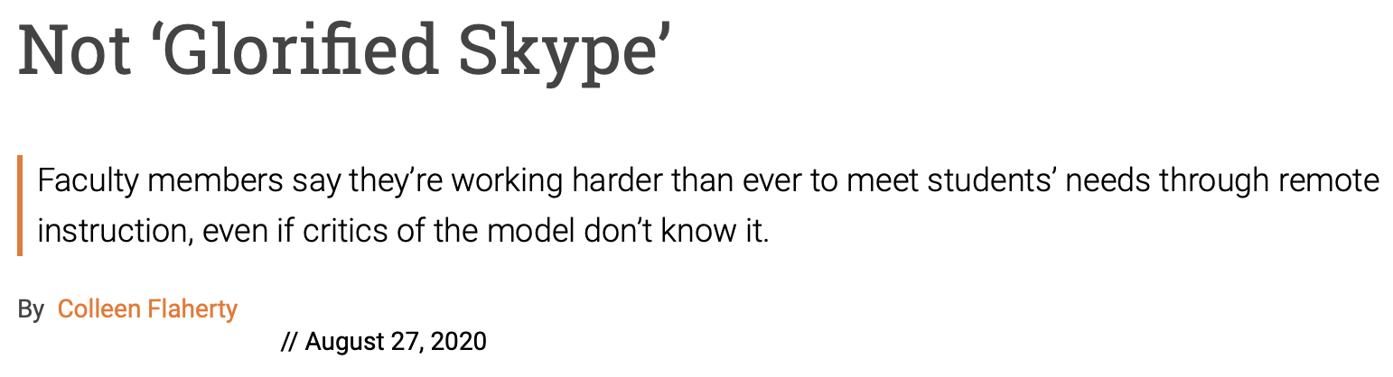
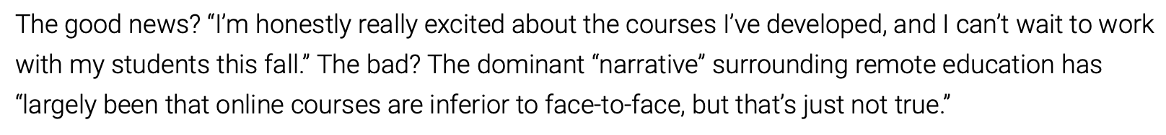
Inside Higher Education
Rose Casey, assistant professor of English at West Virginia University said she’s read widely about online teaching; met weekly with colleagues over Zoom to discuss online pedagogy research, strategies and tools; and overhauled syllabi and teaching materials for her classes. “Like my colleagues, I take teaching seriously, and that means putting in lots of extra time to make sure that students can take courses that are intellectually stimulating without being overwhelming during a pandemic.” The good news? “I’m honestly really excited about the courses I’ve developed, and I can’t wait to work with my students this fall.” The bad? The dominant “narrative” surrounding remote education has “largely been that online courses are inferior to face-to-face, but that’s just not true.”

Slide 16
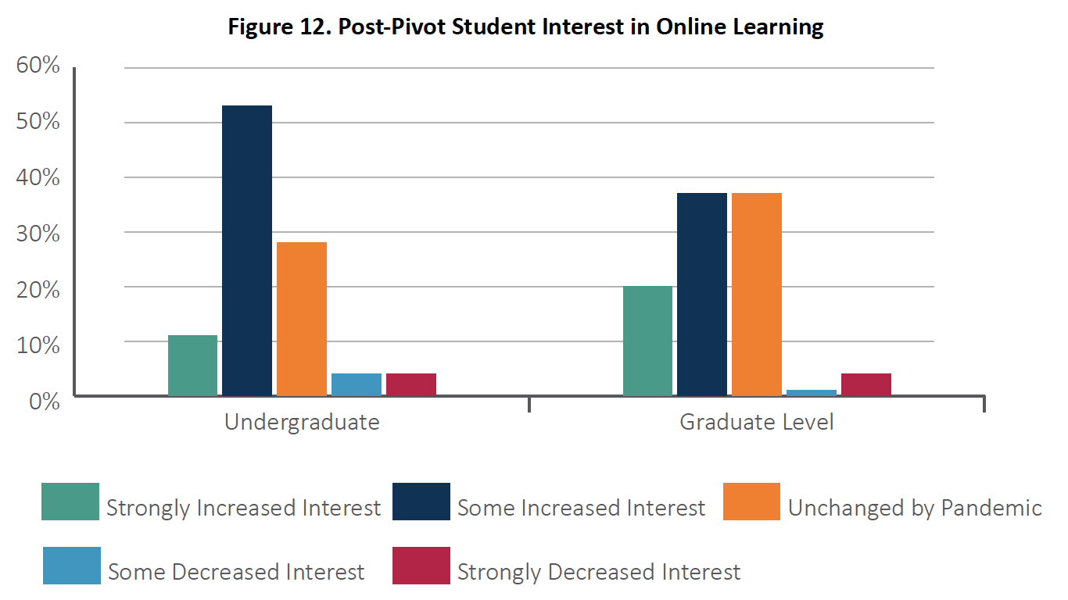
COO judgment of Post-Pivot student interest in Online

Slide 17
Looking ahead: short and long-term Impact of Pandemic experience

Slide 18
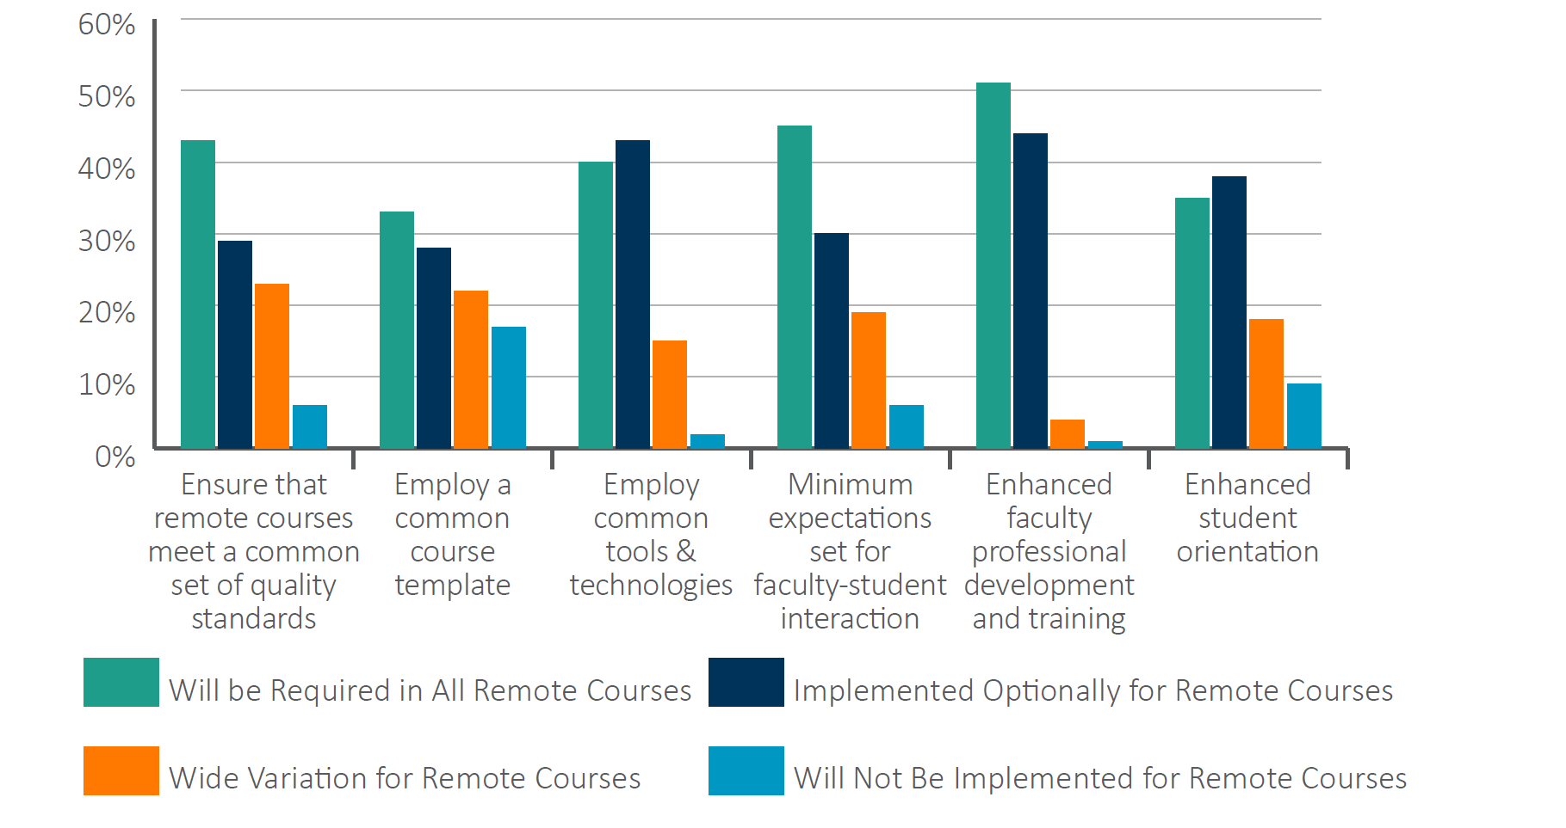
Fall 2020 plans: quality improvements for remote courses

Slide 19
Time for Class, COVID-19 Edition
Part 2, Planning for a Fall Like No Other
[Tyton Partners - Faculty Survey, August-Sept. 2020]
Remote teaching has brought about a positive change in faculty attitudes toward digital learning
Institutions are investing more in digital infrastructure
Institutions are investing more in supporting faculty & student digital learning efforts
2-year institutions are leading 4-year institutions in these efforts
Growing faculty confidence in presence of “ideal” digital learning environment at their institution
10% increase in faculty trust in online learning as an effective method for teaching
Shift in preferred online course format toward blended (+4%) & synchronous (+4%), and away from fully asynchronous (-9%)
Two-thirds of responding faculty are concerned about Equity Gaps among students
Leading remote course redesign steps:
  Revised Learning Objectives, Assessments & Activities
  Introduced new Digital Tools
  Introduced more Active Learning & Evidence Based Teaching strategies

Slide 20
POSSIBLE TRENDS, LOOKING AHEAD TO THE POST-PANDEMIC ERA
(How likely at Your Institution?)
Institutional investment in more robust online infrastructure relative to what existed before?
  Schools with established online programs and presence will move further?
  Schools with little online presence will take the next steps to develop capacity?
More robust orientation, technical, and instructional design support for faculty and students?
Increased competition in higher education, with such initiatives as:
  Aggressively lower pricing for some undergraduate online only programs?
  Menu-based pricing for the unbundled college experience based on true cost of each component?
  Expanded availability of alternative credentials – short applied programs, etc.?
Greater attention among trustees, legislators, and political leaders to the support and regulation of online learning (a double-edged sword). Will it mean:
  Support for increased resources?
  Closer scrutiny of online learning outcomes? Quality Assurance
Expansion of OPM services to facilitate rapid adjustments to course and program delivery modes?

Slide 21
POSSIBLE TRENDS, LOOKING AHEAD TO THE POST-PANDEMIC ERA
(How likely at Your Institution?)
Influx of new users (faculty and students) with a primary orientation toward campus-based instruction?
Demands and expectations of online learning from campus-based faculty and students for more:
  Expanded Engagement strategies
  Synchronous Activity
  Community Building
A relative boost to hybrid or blended courses and programs to support selective integration of online tools and methods where they are perceived as superior to a fully face-to-face approach?
Increasing experimentation with parallel online and face-to-face tracks within courses, making it feasible for institutions, faculty and individual students to quickly shift modes of instruction within a single term or from term to term – emerging “Hyflex” approach
The Digital Divide - Increased focus on equity issues –, including technology access, underserved & unsupported students, and disproportionate outcome achievement

Slide 22
Discussion

Slide 23


CHLOE 5 PLATINUM SPONSORS
Thank You!

