Slide 1
Faculty-Driven Quality Assurance
Program Assessment Through Collaborative Rubric Design
Kristoffer Rees

Slide 2
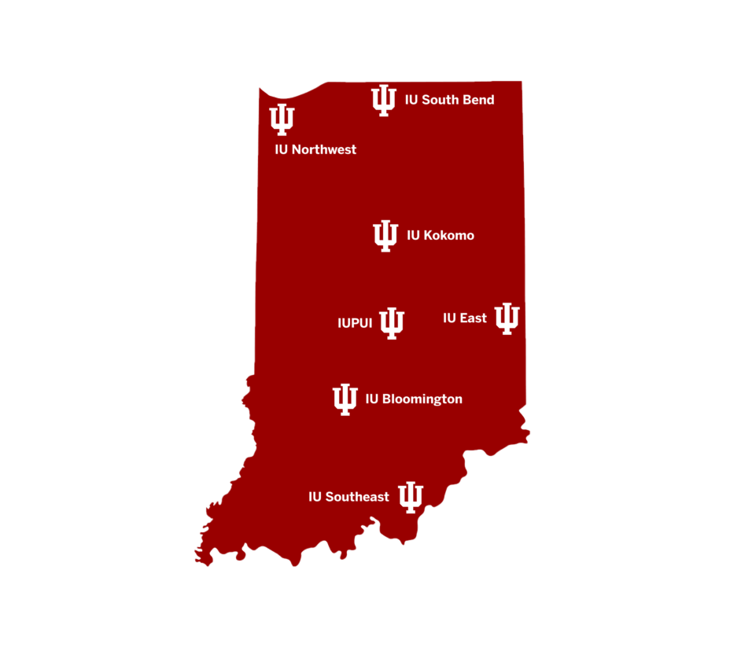
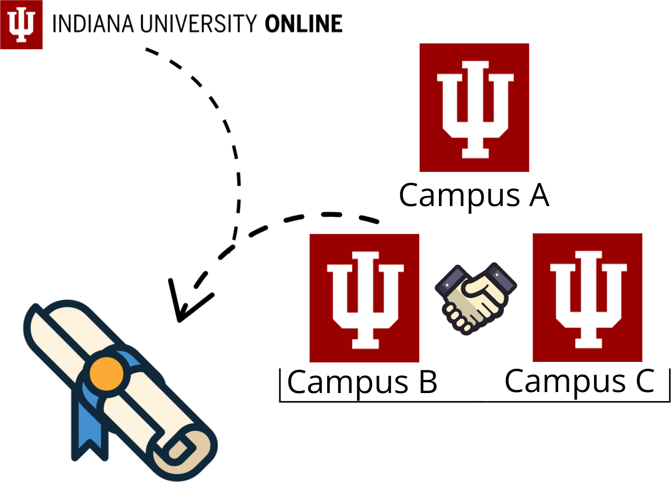
Session Outline
Overview
Challenges Inherited
The (new) IU Online Model for Collaborative Program Assessment
Collaborative Rubric Design
Impact and Outcomes
Application
Comparing Program Assessment Approaches
Going beyond “compliant” to “enthusiastic”
Conclusion
Takeaways
What next?

Slide 3
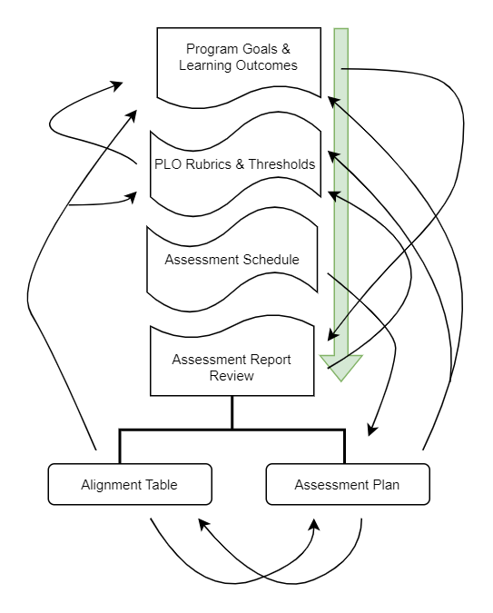
Guiding Principles
Commitment to collaboration
Mindfulness of faculty workload
Embracing iterative nature of assessment
Ensuring assessment is purposeful, sustainable, and strategic

Slide 4
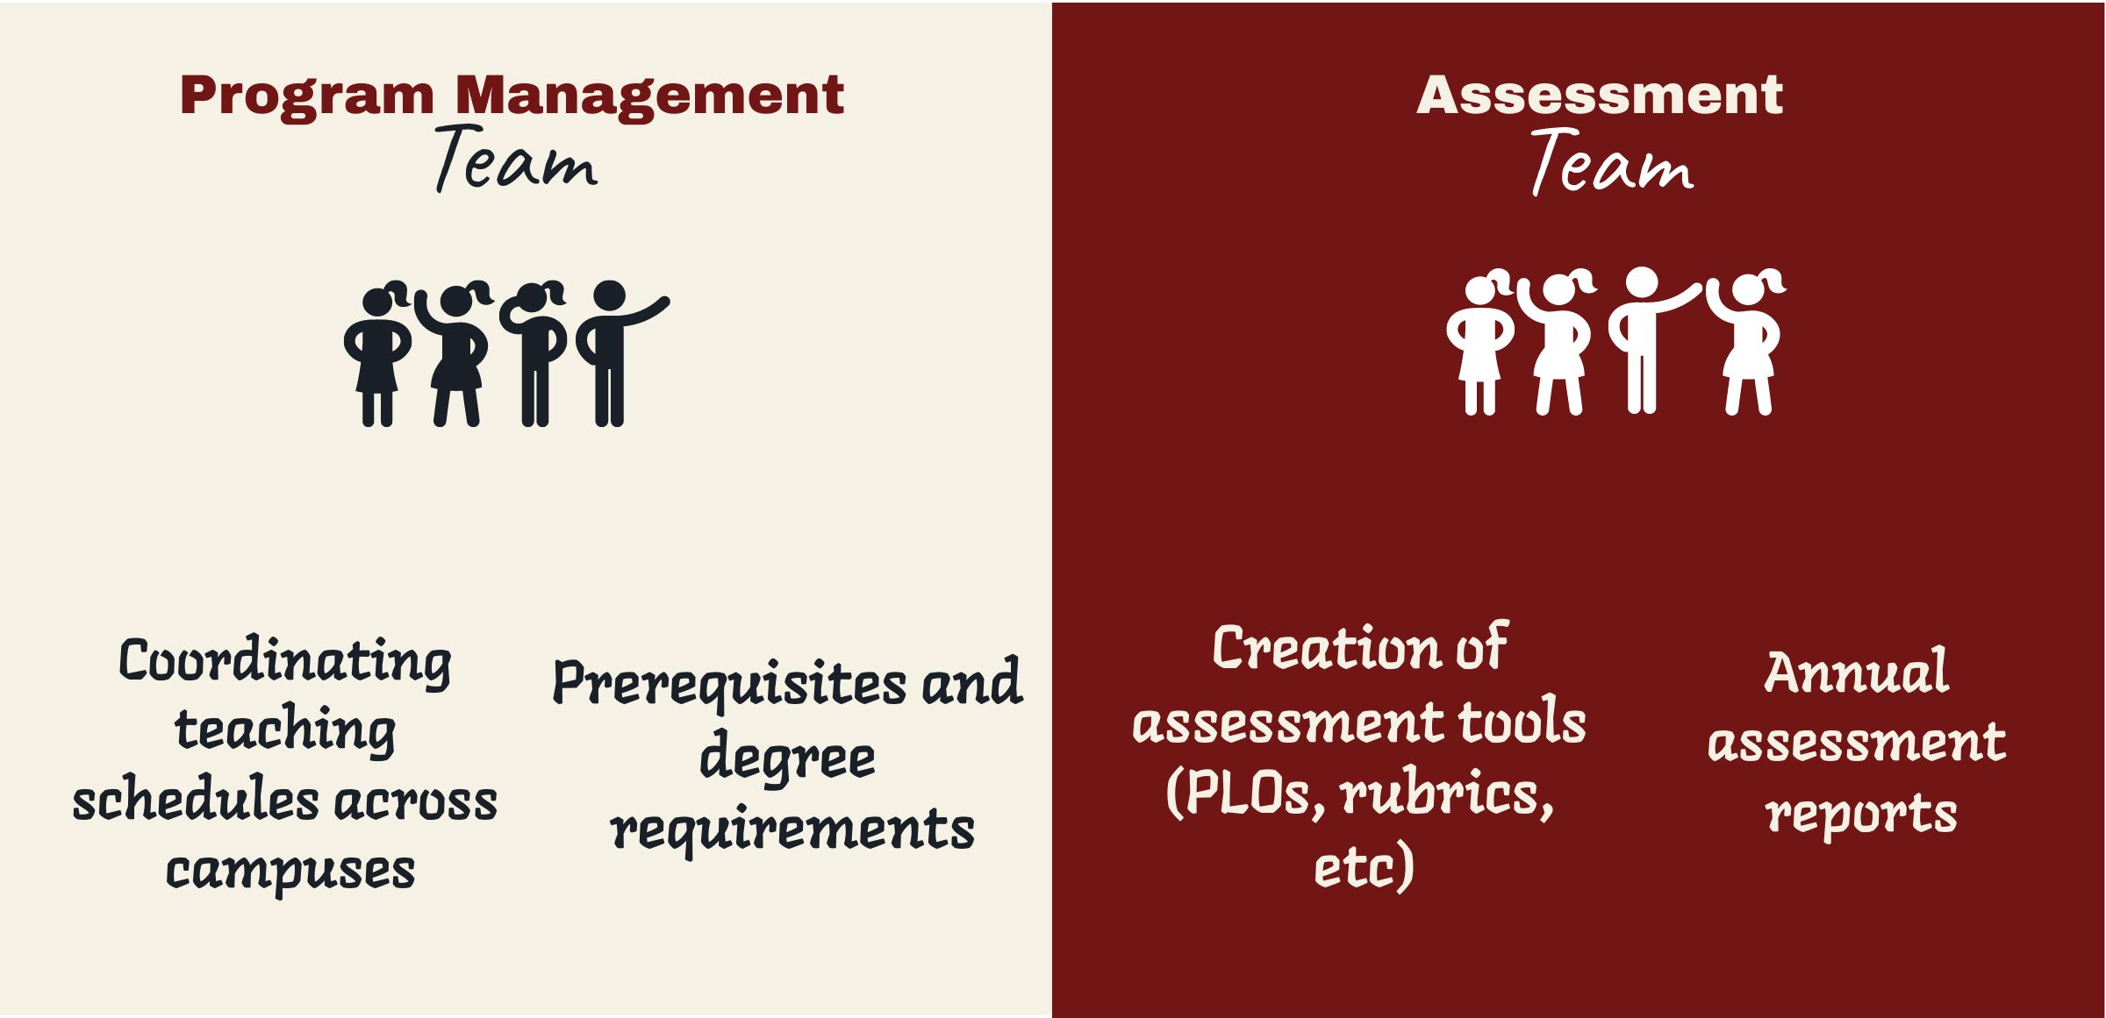
IU Online Collaborative Program Management & Assessment
Faculty Committees maintain control of the degree programs
Curriculum and Assessment Support
Program Managers
Assessment Support Team
Faculty Directors
Notes:
The Program Assessment Team focuses on Program-Level Assessment for Collaborative Online Programs and some Programs of Scale (ProS)
Faculty Committee Meetings are the backbone of decision-making for program assessment.
The faculty committee consists of representatives from each campus participating in the collaborative program.
Due to distance and scheduling, all faculty committee meetings occur via Zoom.

Slide 5
Inherited Program Assessment Landscape
17-18 AY
19-20 AY
20-21 AY
21-22 AY
Pilot Canvas Outcomes for Program Assessment
First Assessment Report Generated
(course grades)
Mixed Program Assessment – course grades, Canvas, & Qualtrics Survey to faculty
Change in staffing; Renewed emphasis on Program Assessment
FALL 2016
Launch of first collaborative online degree

Slide 6
Faculty Committee for Assessment
Two meetings per semester via Zoom
Coordinated by IU Online Program Assessment Team
Charged with:
Establishing/revising Program Goals
Establishing/revising Program Learning Outcomes
Establishing/revising measurable Program Learning Outcome Rubrics
Making Program-related recommendations based on assessment findings

Slide 7
Transformative PLO Process Example
GC CJPS: Core Curriculum PLOs
Original
PLO 01: Identify core components and processes of the criminal justice system and describe and analyze major issues such as: police use of force, the school to prison pipeline, mass incarceration, and other topics of debate with a particular emphasis on diversity issues.
Revised
PLO 01: Evaluate core components and processes of the criminal justice system.
PLO 02: Analyze contemporary challenges facing the criminal justice system as a whole.
PLO 06: Evaluate how extralegal factors such as, but not limited to, age, ethnicity, gender, neurodiversity, race, religion, sexual orientation, and/or social class lead to disparate outcomes in the different components of the criminal justice system.

Slide 8
Collaborative Rubric Design
Assessment Lead Pre-Meeting Tasks
Develop “working” course- and assignment-neutral rubrics for discussion based on PLOs determined by faculty committee.
Rubric Development-oriented Meeting Flow
Share “working” rubrics and determine performance thresholds
Facilitate / moderate discussion
Revise in real-time based on faculty consensus
SME 1:1 meetings where appropriate to prepare for committee discussion
Criteria/ Performance Indicator | Exceeds Expectations 3 pts | Meets Expectations 2 pts | Below Expectations 1 pt | No Submission/No Evidence 0 pts

Slide 9
Example of Starting and Completed Rubrics
Starting Point: Adapted AAC&U Rubric Template
BS Business Administration: Pre-Revision | Revision | Post-Revision
GC / MAT Chemistry: Pre-Revision | Revision | Post-Revision
GC Criminal Justice Leadership and Management: Pre-Revision | Post-Revision
MAT Education: Pre-Revision | Post-Revision

Slide 10
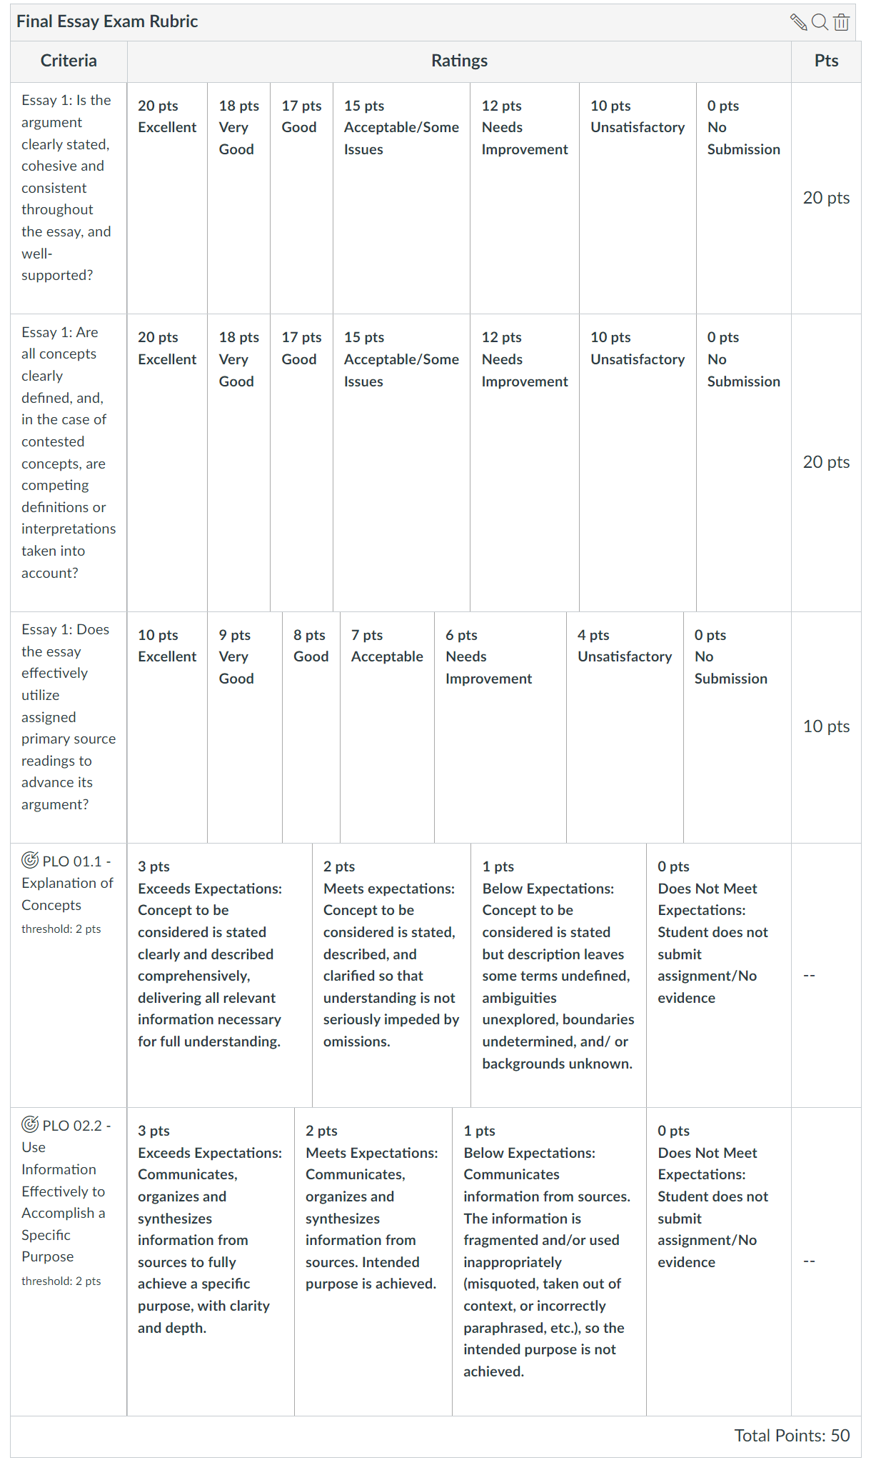
Implementation and Data Collection
Outcome-aligned rubrics incorporated into courses identified for program assessment after discussion with course instructor
Integrates with most grading workflows

Slide 11
Transforming the Faculty Experience

Slide 12
Course Instructor Reflections
Faculty reflection solicited at the end of each semester
Provide feedback on rubrics and process
Share programmatic ideas and/or concerns
Pilot: Fall 2021
Rollout: Fall 2022

Slide 13
Instructor Feedback on Assessment Rubrics
Reflection Question
“After scoring, describe how well the rubric/PLO fits your course/assignment and met your expectations for alignment.
Include any PLO/rubric revisions you might recommend to the Faculty Committee.”
Reflection Responses Summary
76% of respondents AY21-23 addressed this question.
61% commented favorably on the rubric.
“It fits well…”; “I had no problems with the rubric…”; “I think the rubric provided was very simple yet effective…”; etc.
90% of non-favorable responses offered detailed, actionable suggestions for revision.

Slide 14
Your Turn
Overview
Small Group Discussions
Three Groups
One Facilitator per Group
Whole Group Debrief
Actionable Recommendations
Appraising and Improving Program Assessment

Slide 15
Small Group Discussion – Focus Questions
Take approximately 5 minutes to discuss the following:
What is program assessment like at your institution?
What is one strategy from today’s presentation that you could implement to improve program assessment at your institution?
Thinking about your experience with program assessment, how could we further improve our approach?

Slide 16
Full Group Debrief and Action Items
Each Group to Share:
One change you could see making to program assessment based on our presentation and the small group conversation.
One recommendation for the IU Online Assessment Team to further improve our process.
Group Discussion:
How to build and sustain a culture of enthusiasm for assessment among faculty?
Compliant vs. engaged

Slide 17
Takeaways and What Next?

Slide 18
Takeaways…
Engaging faculty across the various entry points for assessment is difficult
Intentional, highly scaffolded, approaches to supporting faculty-driven assessment design improve engagement and compliance
A dedicated cross-program assessment team improves consistency and scalability and reduces faculty burden
Structure helps faculty engage with assessment, but flexibility sustains their engagement
Empowering faculty to determine the assessment implementation at both strategic and on-the-ground levels builds buy-in

Slide 19
…and What Next
Program-level rubric-norming
Reviewing use of criteria – planned vs actual
Measures of “student success” increasingly rely on student learning outcomes assessment
E.g. HLC, Revised Criteria for Accreditation
Criterion 3.E. – Assessment of Student Learning
Notes:
HLC Criteria Examples from their new Providing Evidence Guide
Assessment committee meeting minutes
Curriculum maps & rubrics
Course, program, and institutional level learning goals and outcomes.
Annual assessment reports using direct measures of assessment
Assessment plan, process, and cycle

Slide 20
Selected References and Theoretical Grounding
Banta, T. W., Jones, E. A., & Black, K. E. (2009). Designing effective assessment: Principles and profiles of good practice. John Wiley & Sons.
Doohan, E. A., Lawless, B., & Ho, E. Y. (2022). Are students learning what we want them to learn? A communication program assessment. Communication Teacher, 36(1), 54-66.
Fulcher, K. H., & Prendergast, C. (2021). Improving student learning at scale: A how-to guide for higher education. Taylor & Francis.
Lindauer, J. R., & Coward, P. A. (2021). Assessment of student learning in the arts, humanities, social sciences, and sciences. In Exemplars of Assessment in Higher Education (pp. 26-38). Routledge.
Stevens, D.D., & Levi, A.J. (2012). Rubrics and Program Assessment. In Introduction to rubrics: An assessment tool to save grading time, convey effective feedback, and promote student learning. Routledge.

Slide 21
Thank You! Questions and Feedback
Feel free to reach out at any time: IU Online Program Assessment Team: iuoasmt@iu.edu

