Slide 1
Online Education Institutional Leaders
How are they addressing, regulation, quality assurance, and innovation?
Ron Legon, Senior Adviser for Knowledge Initiatives, QM
Richard Garrett, Chief Research Officer, Eduventures
Eric Fredericksen, Associate V.P. for Online Learning, U of Rochester
QM Regional Conference
Accreditation, Regulation, and Compliance – Oh My!
April 21, 2017

Slide 2
The Chief Online Education Officer
An Emerging Role in Mainstream Online Education

Slide 3
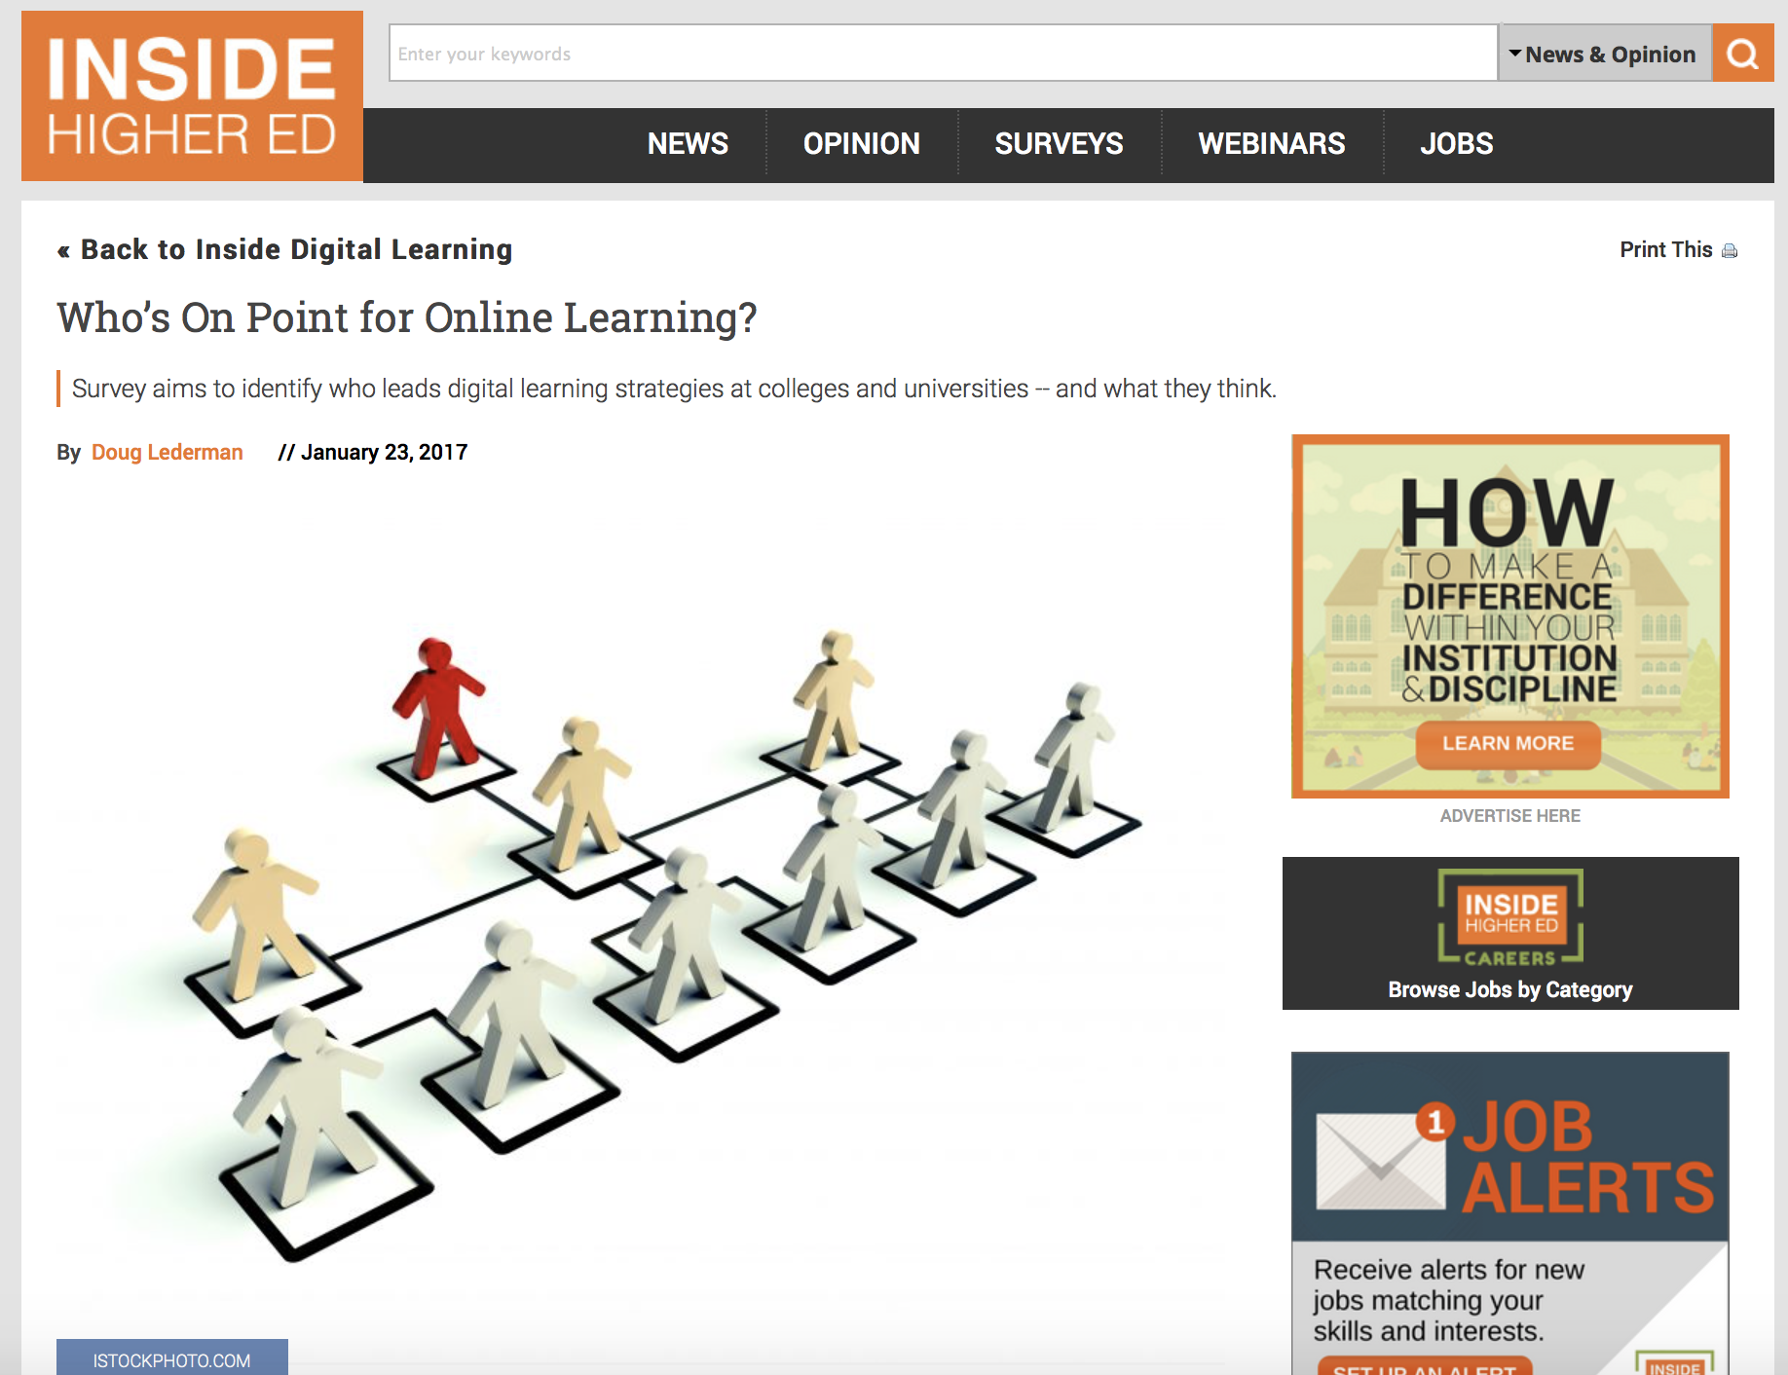
A national study of leadership for online learning in US higher education
Eric E. Fredericksen, EdD
Associate Vice President for Online Learning &
Associate Professor in Educational Leadership

Slide 4
Goals of the Study
Develop a systematic and comprehensive list of leaders for online learning in US Higher Education
Collect institutional data for context
Gather information about the position and professional experience of the leader
Capture demographic and other information about these individual leaders
Investigate the potential relationships among these factors and dimensions

Slide 5
Who is on point for online learning in colleges and universities in the US?
How do you find out when there is no existing list?
Review of institutional web sites and search for:
  Organizational charts
  President and Provost cabinets
  Online learning / education
  eLearning
  Distance education / distance learning
  Instructional / academic/ educational technology
  Centers for Instructional Innovation / Teaching Excellence
  Global Campus / World Campus / Virtual Campus / Extended Studies
  Campus / Faculty / Staff / Office Directories
  Press releases
Sometimes it takes 5-10 minutes… other times, much longer
Variation in title
Systematic approach – by Carnegie Classification
(what else would you do in your free time in the summer?)

Slide 6
Methodology
In Summer 2016, the PI investigated and reviewed the web sites of colleges and universities in the US.
The systematic approach was organized by Carnegie Classification – starting with R1 institutions, then R2, R3, M1, M2, and M3 (so far) and data was collected in these waves. (1088 institutions were explored)
  R1 – initial invitation on June 8 with reminders on June 13, 20, 27
  R2 – initial invitation on June 13 with reminders on June 20, 27 and July 5
  R3 – initial invitation on June 20 with reminders on June 27 and July 5, 11
  M1 (part 1) – initial invitation on June 27 with reminders on July 5, 11, 18
  M1 (part 2) – initial invitation on July 5 with reminders on July 11, 18, 25
  M2 – initial invitation on July 11 with reminders on July 18, 25 and August 1
  M3 – initial invitation on July 18 with reminders on July 25 and August 1, 8
The survey consisted of 30 multiple-choice questions that utilize a Likert-type scale and two open ended questions.
The study reached out to 820 individuals and 255 of them responded to this web-based survey – resulting in a 31% response rate.

Slide 7
How many years ago did your institution create a leadership position for online learning?

Slide 8
Whom do you report to?

Slide 9
In addition to your leadership role for online learning, do you also hold a faculty appointment?

Slide 10
How many years of experience do you have?
F2F classroom teaching?
Online teaching?
Educational research?
Management/leadership?
Instructional design?
IT?

Slide 11
Have you been an online student?
(credit bearing)

Slide 12
Has your institution used your online learning efforts as a catalyst for organizational changes?

Slide 13
What groups at your institution have been unified within your organization?

Slide 14
How do you and your institution define the scope of online learning for your position?

Slide 15
What are the highest level strategic goals for online learning at your institution?

Slide 16
What are the top priorities or issues related to online learning for you and your institution?
Faculty Development and Training
Strategic planning for online learning at your institution
Staffing for instructional design and faculty support
Funding and resources at your institution
Providing student support
Marketing and promotion of online courses and programs
Development of institutional policies for online learning
Insuring academic integrity
State Regulations and SARA (State Authorization and Reciprocity Agreement)
Evaluation / Implementation of learning management systems
Learning analytics
Conducting research about the effectiveness of online learning
Working with Online Education Service Providers
Development of a MOOC strategy

Slide 17
Summarizing the Key Findings
While 29% of the Online Learning Leadership positions were created more than 10 years ago, the majority have been created in the past 5-6 years.
Counter to a strict focus on distance education, more than 60% report responsibility for supporting all types of courses.
Almost 3 out of 4 institutions report using online learning efforts as a catalyst for organizational change.
The majority of Online Learning Leadership positions report to the Provost of the institution.

Slide 18
Summarizing the Key Findings
Overall, the top three highest level strategic goals are:
  Grow institutional enrollments above existing levels,
  Promote instructional innovation, and
  Promote student engagement.
The top three priorities or issues are:
  Faculty Development and Training,
  Strategic planning for online learning at your institution, and
  Staffing for instructional design and faculty support.
The top three association the leaders belong to for professional development are OLC, ELI, and QM.
The use of external online learning service providers is very limited with the exception of Hosting of the Learning Management System (30%) and some modest efforts with Marketing and Recruitment (13%).

Slide 19
Seasoned leaders
86% of leaders have more than 11 years of experience in higher education and 45% have more than 20 years
75% of leaders are at least 45 years old
2 out of 3 leaders hold a doctoral degree
Half of the respondents indicated that they also hold a faculty appointment.
The majority report taking an online course(s), capturing the experience as an online student.
As expected, there is some variation in background, but most have a blend of experience:
  70% have at least 6 years of face to face teaching experience (and ¼ have more than 20)
  More than 3 out of 4 have taught online for at least a year (half for more than 6 years)
  2/3 have more than 11 years of management/leadership experience
  Half of the leaders have 6 or more years of educational research experience
  62% of leaders have 6 or more years of instructional design experience
  60% have at least one year of IT experience (but 36% have no IT experience)

Slide 20
Genesis of the CHLOE Survey
The Changing Landscape of Online Education
IPEDS has expanded to include online education
OLC/Babson survey has terminated
Gaps apparent in ongoing surveys, e.g.
  The ITC Survey focuses only on Community Colleges
With online education increasingly going mainstream QM and Eduventures identified need for greater focus on
  Resources and management
  Emerging tools and methods
  Quality Assurance
  Regulation and Accreditation

Slide 21
Chief Online Education Officers
What do they see as the metrics that matter most to accreditors and regulators?
What are chief online officers’ preferred/ideal metrics?

Slide 22
Quality Metrics
Current Metrics of Accreditors & Regulators | Chief Online Officers’ Preferred Metrics
Student achievement of program objectives – 87% | Student achievement of program objectives – 87.5%
Student retention & graduation rates – 73% | Student retention & graduation rates – 86%
Faculty credentials – 70% | Program reputation – 62.5%
Faculty training – 47% | Faculty Training – 52%
Student engagement measures – 33% | Post-graduation placement/employment – 50%
Post-graduation placement/employment – 33% | Student engagement measures – 35%
 | Employer Feedback – 34%
 | Faculty credentials – 31%

Slide 23
Adequate Data on Outcomes?
 | Public 2Y | Public 4Y | Private 4Y
Retention/Graduation Rates | 86% | 72% | 85%
Student Achievement of Program Objectives | 60% | 61% | 73%
Loan Repayment Statistics | 57% | 57% | 66%
Standardized Test Performance | 34% | 46% | 59%
Student Debt | 46% | 50% | 63%
Post-Graduation Employment | 37% | 39% | 54%
Graduate Earnings | 34% | 32% | 46%
Employer Feedback | 40% | 25% | 34%
External Certifications | 51% | 39% | 49%
Alumni Feedback | 26% | 43% | 49%

Slide 24
Which Student Outcomes
Should be measured?
Are institutions ready to measure and be measured by a wider array of student outcomes measures?
Should regulators and accreditors take active steps to encourage broader assessment of student outcomes?

Slide 25
Prevalence of Quality Assurance
Are quality standards in place for all aspects of online learning?
Are there gaps?
How are institutions embedding quality standards in their culture?
How important is external validation of quality?

Slide 26
Quality Metrics Adopted
Quality Metrics Adopted and Applied Internally

Slide 27
Training on Quality Metrics

Slide 28
Certification of Quality Metrics

Slide 29
Technology and Innovation
Will mainstream adoption of online learning maintain, accelerate, or slow its transformative momentum?
Will mainstream online learning lead or embrace the next transformative innovations in higher education?

Slide 30
Most Important/Innovative
Developments in Online Learning

Slide 31
Most Attractive New Tools
and Techniques

Slide 32
Anticipated Rate of Change

Slide 33
Stability vs. Innovation
Our findings suggest that mainstream online learning may not be the disruptive force that developing online learning once was.
Achieving stability in cost and enhancing quality may be higher priorities for many Chief Online Officers than risk taking and innovation.
Foundations are clearly trying to stimulate further educational innovation – but is that a goal for regulators and accreditors?
Could/should regulators try to squeeze more innovation out of online learning?

