Slide 2
Active/Applied Research on Online Learning and
Quality Assurance
February 27, 2025 | Online

Slide 5
Student Perceptions of QM Standards on Engagement and Learning
Daisyane Barreto
Sheri Conklin
University of North Carolina Wilmington

Slide 6
Let’s meet Sarah!

Slide 8
1. What are online student perceptions of the impact of QM standards on their learning?
2. What are online student perceptions of the impact of QM standards on their engagement?

Slide 9
Participants
Graduate students
Non-QM certified programs
Nurse Educator
Healthcare Administration
Instructional Technology
Forty-two students completed the survey

Slide 10
Results:
Students perceptions of Learning
Accessibility and Usability
(76.80 a lot)
Assessment and Measurement (72.21 a lot)

Slide 11
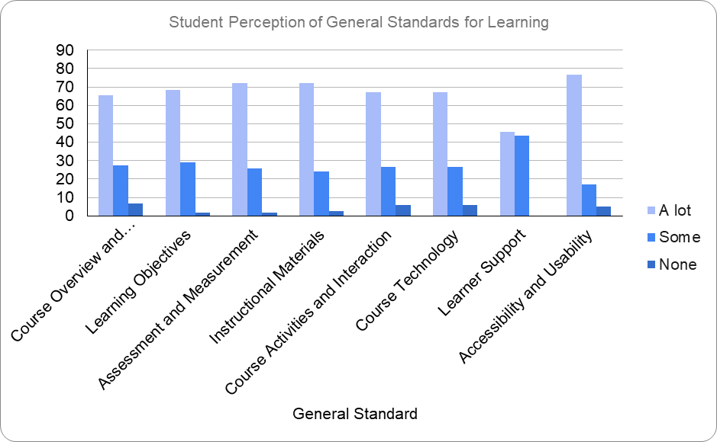

Slide 12
What does this finding mean to you and your course?
What changes would you make to your course based on this?

Slide 13
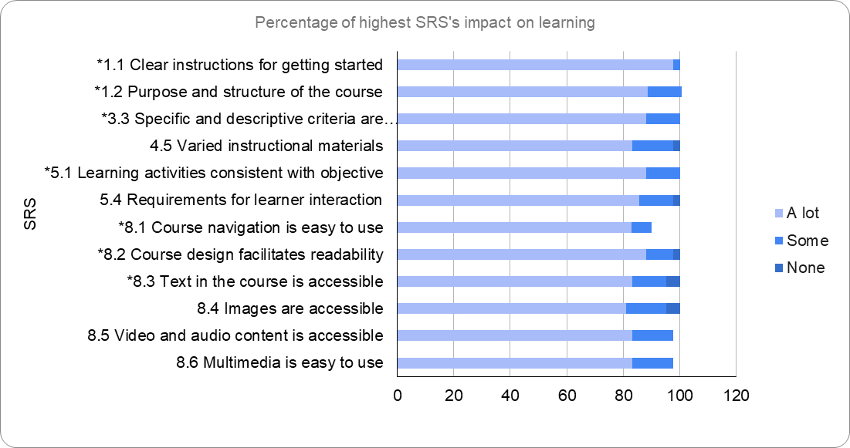

Slide 14
Results:
Students perceptions of Learning
Open ended questions
Course Activities and Learner Interaction (58.9 a lot)
Accessibility and Usability (58.49 a lot)

Slide 15
Students’ Perceptions of Learning
The clear outline of the course in each module helps me understand what is expected of me.
Because I am a visual learner, this kind of resource [video/audio] provides a visual means to learn and review the material

Slide 16
Results: Student perceptions of learning
Survey categories | Frequency | Percentage
Accessibility and Usability | 7 | 32
Course Activities and Learner Interaction | 5 | 22.7
Instructional Materials | 4 | 18
Assessment and Measurement | 3 | 13.6
Course Overview and Introduction | 2 | 9
Learner Support | 1 | 4.5
Video and audio content in the course is accessible." Because I am a visual learner, this kind of resource provides a visual means to learn and review the material
The clear outline of the course in each module helps me understand what is expected of me. I like that I can look ahead to see what I will be learning as well as what weeks/modules are the "busier" ones.

Slide 17
Results:
Students perceptions of Engagement
Course Activities and Learner Interaction
(84.80 a lot)
Accessibility and Usability
(83.19 a lot)

Slide 18
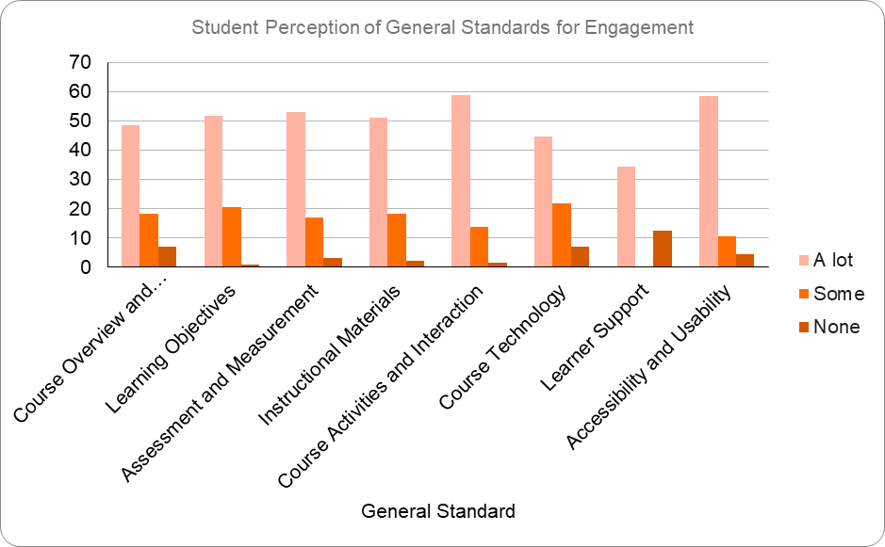

Slide 19
1. What does this finding mean to you and your course?
2. What changes would you make to your course based on this?

Slide 20
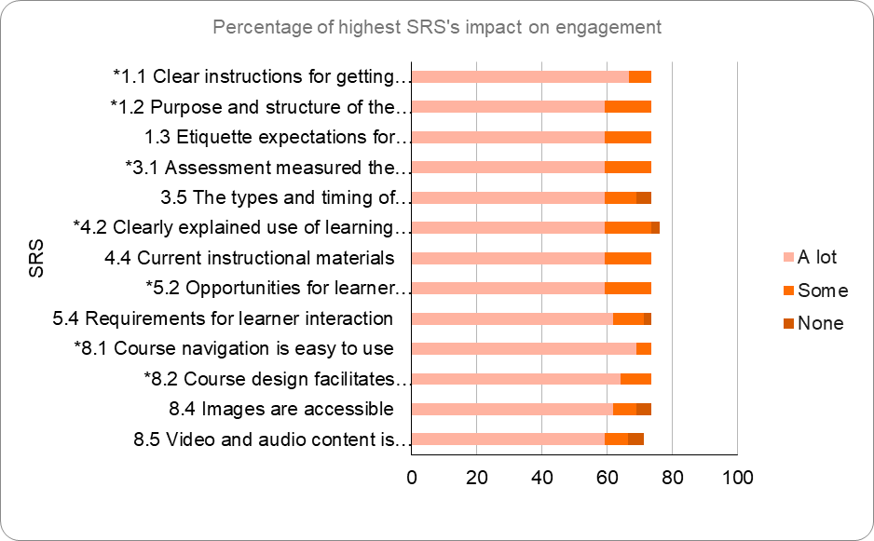

Slide 21
Results:
Students perceptions of Engagement
Open ended questions
Course Activities and Learner Interaction (42.8%)
Instructional Materials (28.5%)

Slide 22
Students’ Perceptions of Engagement
Professor engagement and level of care for the course. The more engagement and quality of feedback from them, the more I want to be engaged in the course.

Slide 23
Discussion: Research and Practice
Assessment and Measurement
A variety of accessible instructional materials
Clear expectation of grading policy
Feedback
Clear connection between learning objectives and activities/assessments

Slide 24
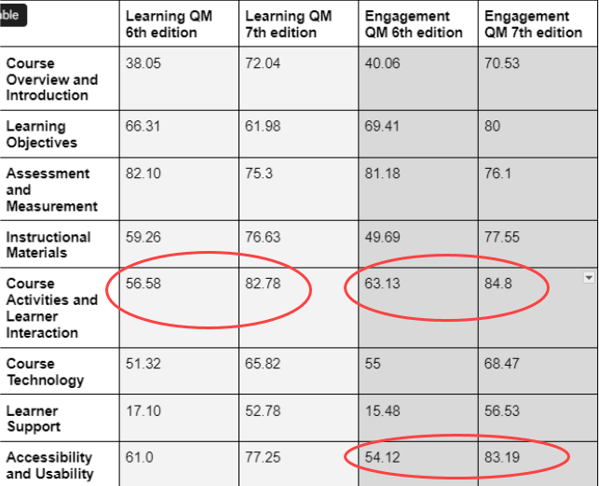
Results: Students perceptions of learning and engagement

Slide 25
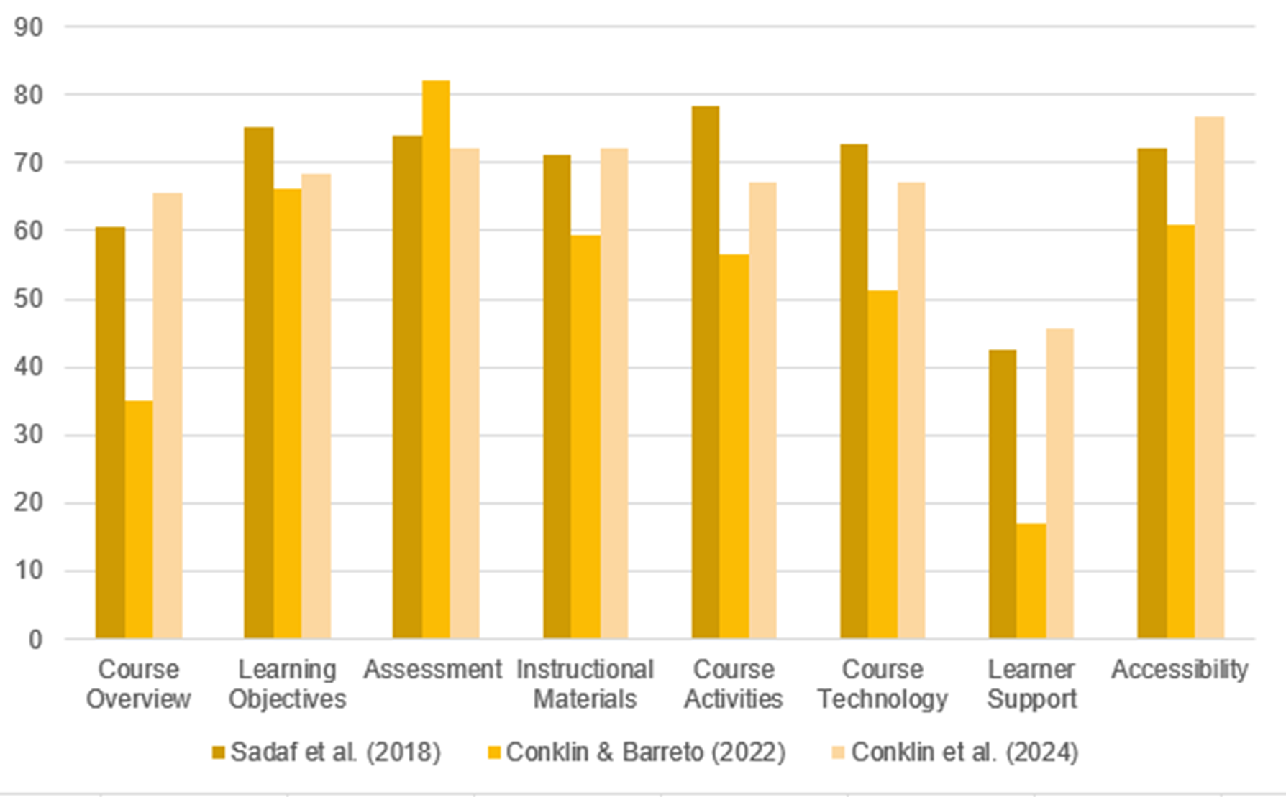
Learning

Slide 26
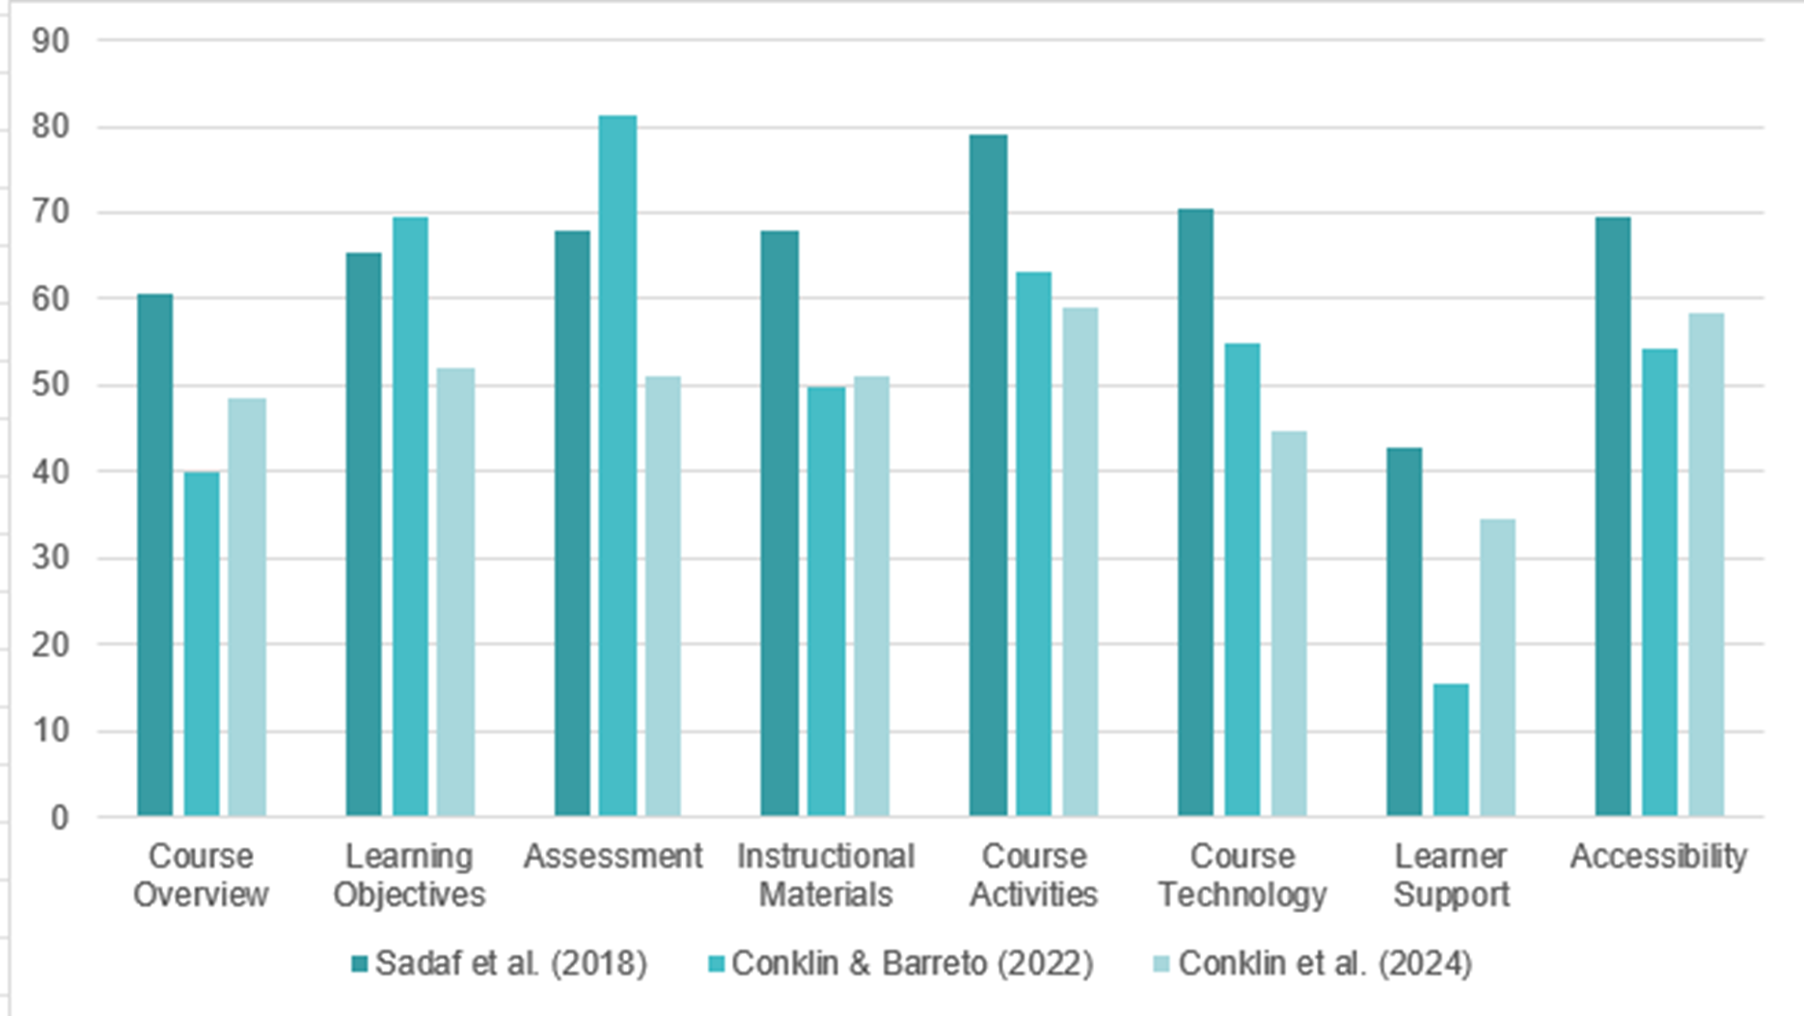
Engagement

Slide 27
Limitations
Students exposed to QM informed
Non QM certified courses

Slide 28
How can we design an online experience in which Sarah can learn and be engaged?

Slide 29
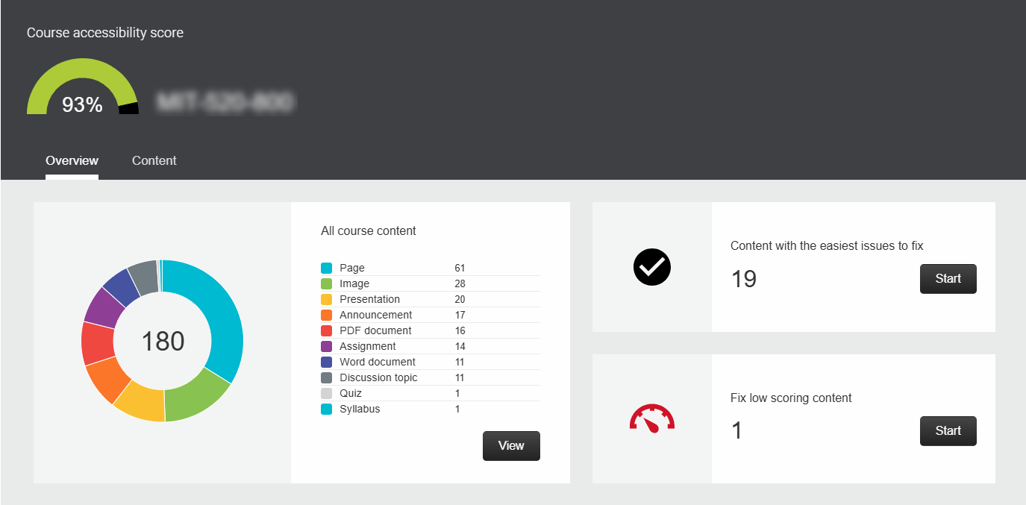
Accessibility
https://tinyurl.com/5n744pnw

Slide 30
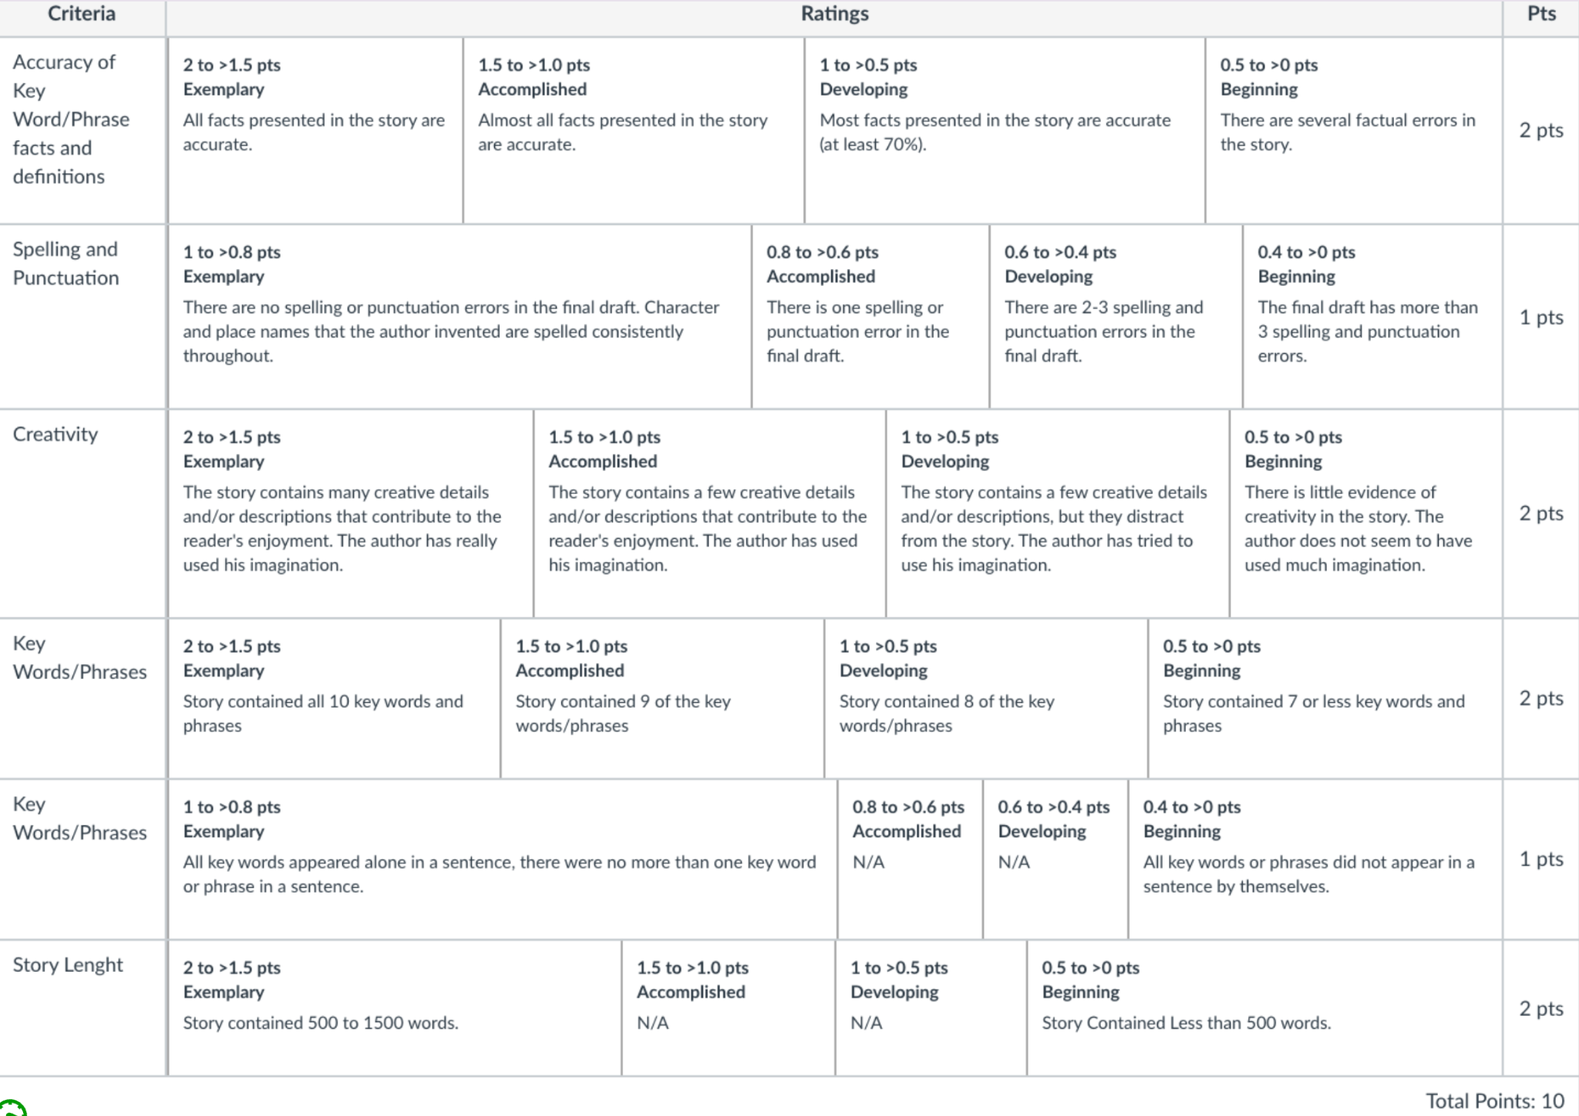
Grading Criteria

Slide 31
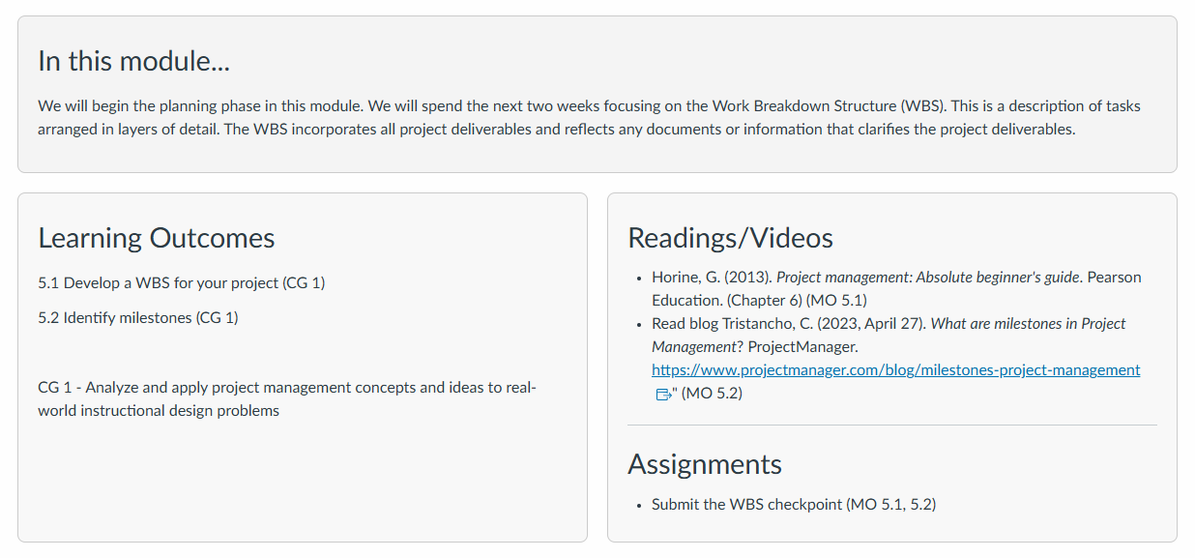
Showcase alignment
https://tinyurl.com/bddy39zs

Slide 32
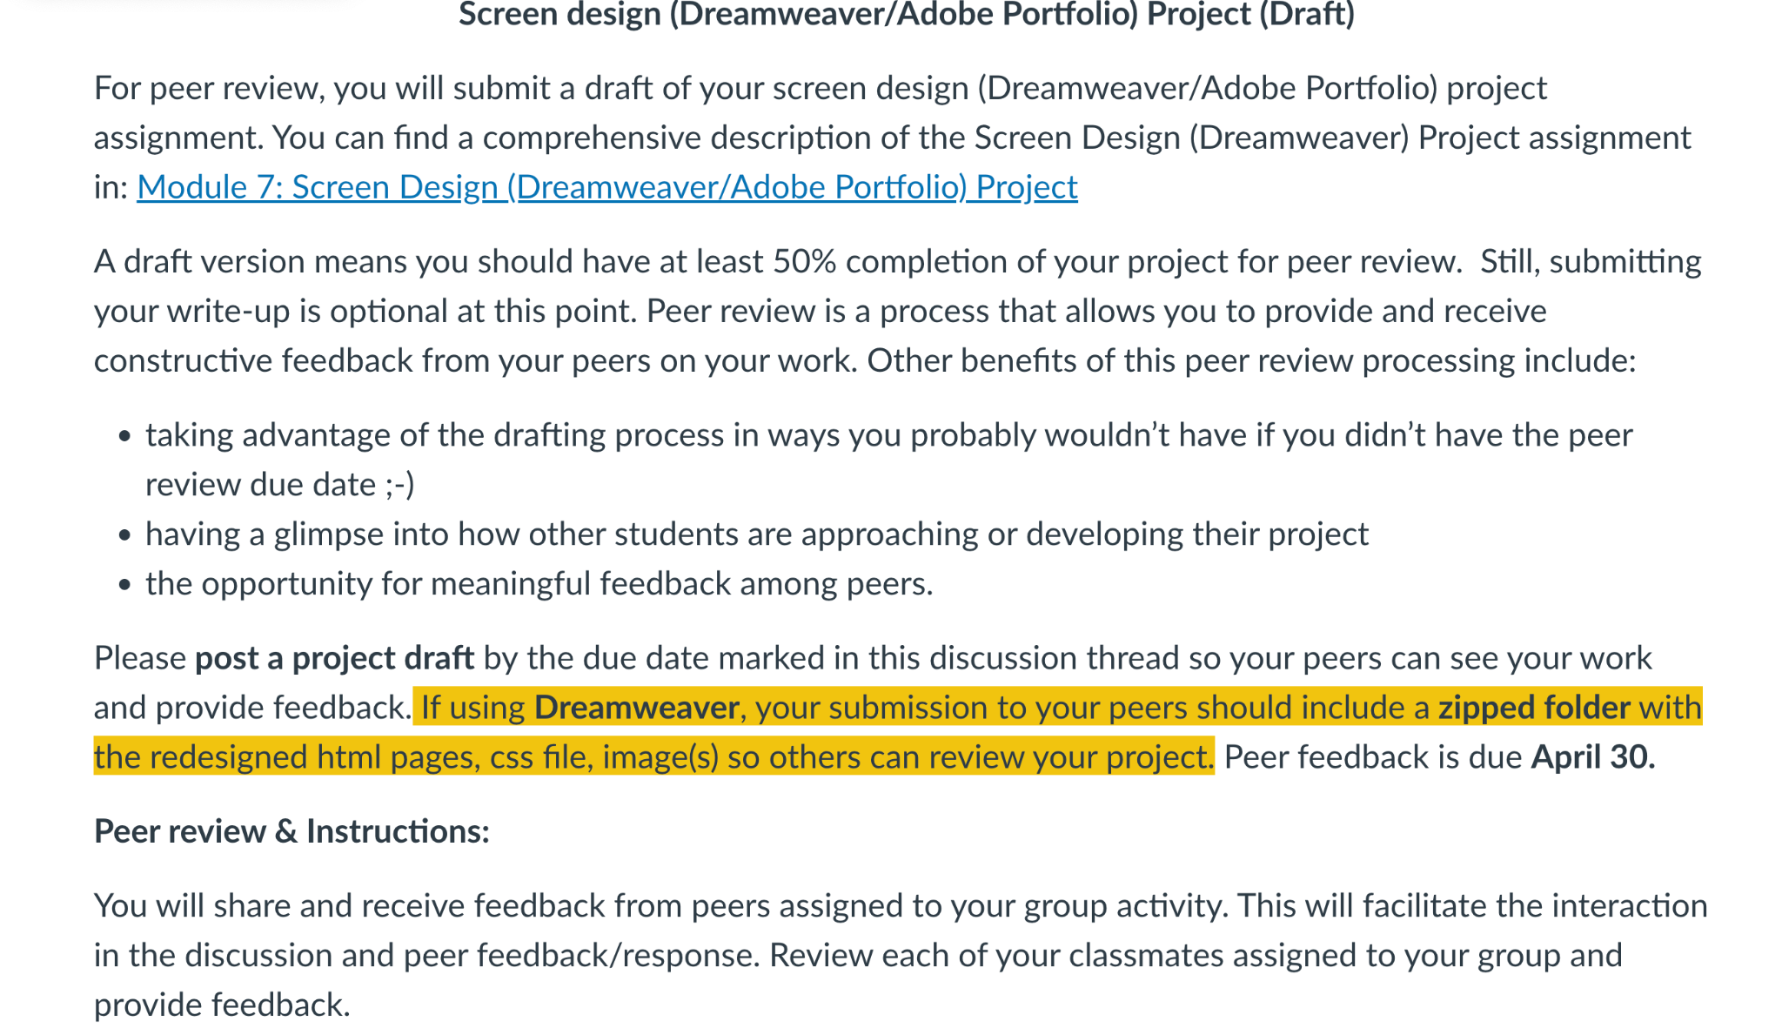
Alignment between Course Activities and Learning Outcomes

Slide 33
Questions
Feel free to access the article: Student Perceptions of Quality Matters Standards on Engagement and Learning

