Slide 1

Designing Learning
That Promotes Transparency
& Student Success:
Applying the TILT
(Transparency in Learning & Teaching)
Model
Melony Shemberger, Ed.D.
Associate Professor, Journalism/Mass Communication

Slide 2
Think for a minute
Describe an experience or an outcome in which you were tasked to do something new or unfamiliar.
How did you complete the task?
Were you successful?
Why?
What could have been done differently?

Slide 3
Thoughts on transparency
What does transparency mean to you?
What does transparency look like to a student?

Slide 4

My journey to

Slide 5
Introduction: TILT Model
Transparency in Learning and Teaching (TILT)
Small teaching approach to enhance student learning.
Explaining to students why they are performing particular activities, such as assignments and projects.
Purpose, task and criteria: All three align to demonstrate relevancy to the student.

Slide 6
Session objectives
By the end of this session, participants will be equipped to do the following:
Have a draft assignment or activity to “TILT” in a course.
Apply TILT to design future transparent assignments.
Examples from a recent online journalism course will be provided, as well as resources.

Slide 7
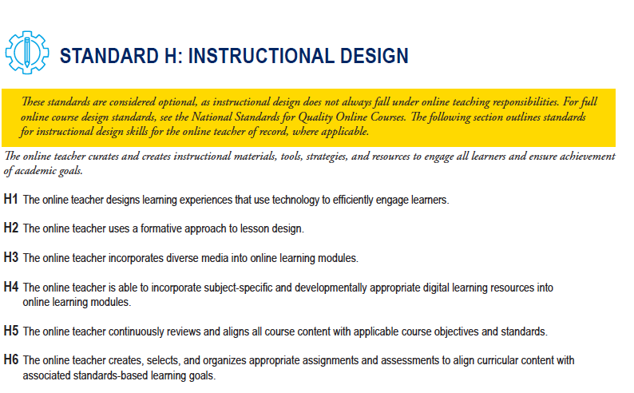
National Standards for Quality Online Teaching, 2019

Slide 8
QM Rubric (HE)
Specific Review Standards from the QM Higher Education Rubric, Sixth Edition
Learning Activities and Learner Interaction
5.1 The learning activities promote the achievement of the stated learning objectives or competencies.
5.2 Learning activities provide opportunities for interaction that support active learning.

Slide 9
Benefits of TILT
Makes learning processes explicit.
Fosters students’ confidence.
Enhances student success (Winkelmes et al., Peer Review, spring 2016).
Boosts student retention rates (Winkelmes, Calkins, Ke, forthcoming).
Helps the faculty member to think more intentionally about the activities assigned.

Slide 10
Purpose
Define the learning objectives that will help students recognize how this assignment will benefit their learning.
Skills and knowledge

Slide 11
Task
Define the activities the student should do/perform.
List steps, instructions, guidelines, sequence.
Any errors to watch? Mistakes to avoid?

Slide 12
Criteria for success
Tell students what they should be able to do.
Provide examples (full or annotated) of what the desired characteristics look like in real-world practice.
Discuss how excellent work differs from adequate work.
Provide a rubric, checklist.

Slide 13
Other tips
Name every assignment given.
Your module learning objectives should guide the design of your assignments and activities.

Slide 14
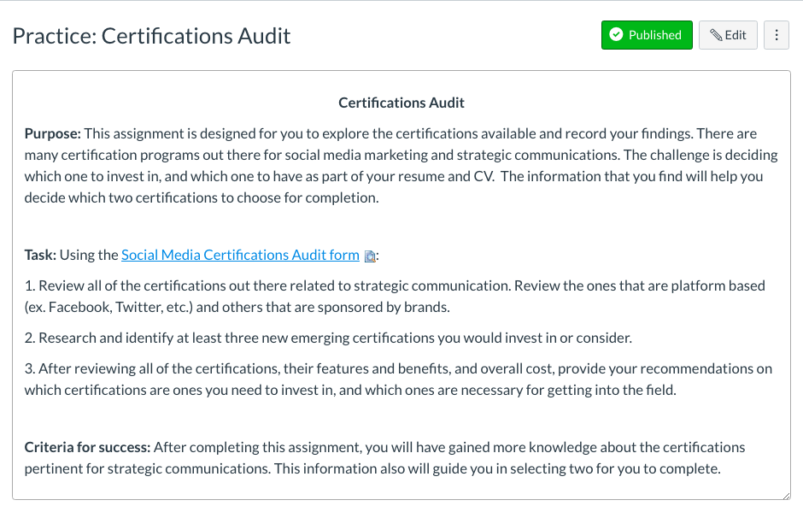

Slide 15
Practice

Slide 16
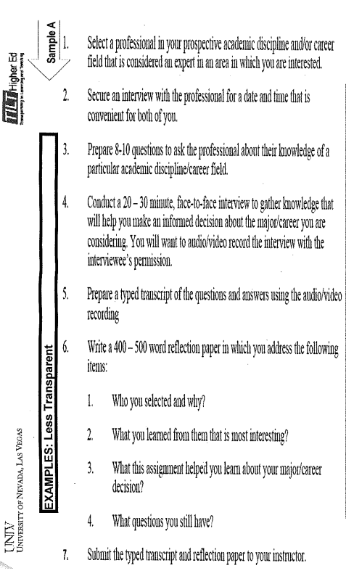
Example
Less transparent assignment

Slide 17
Going full TILT
Identify a course to apply TILT.
What assignment or activity would you like to see improved?
Design the assignment or activity using TILT.

Slide 18
Bibliography
Winkelmes, M. “Equity of access and equity of experience in higher education.” National Teaching and Learning Forum 24, 2 (February 2015).
Winkelmes, M.; Bernacki, M.; Butler, J.; Zochowski, M.; Golanics, J.; Weavil, K. H. “A teaching intervention that increases underserved college students’ success.” Peer Review (winter/spring 2016), forthcoming.

Slide 19
Thank you
Melony Shemberger, Ed.D.
270-809-6874
mshemberger@murraystate.edu
@DrMelShemberger

