Slide 1
Teaching Learners to Research Smarter
Creative Approaches to Information Literacy Design
Melony Shemberger, Ed.D.
Professor, Journalism & Mass Communications
JMC Undergraduate Assessment Coordinator
Murray State University | Murray, Kentucky

Slide 2
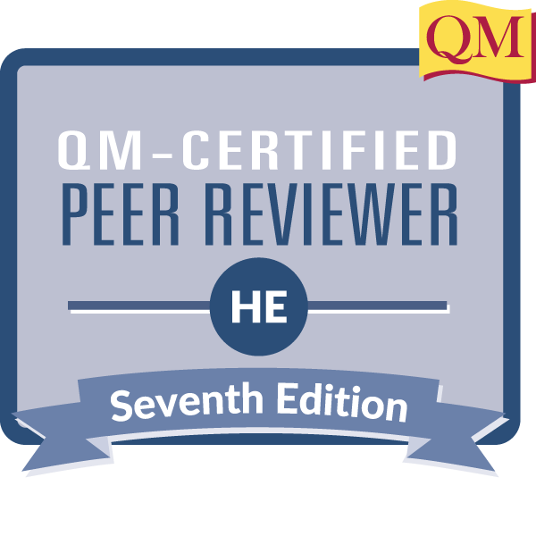
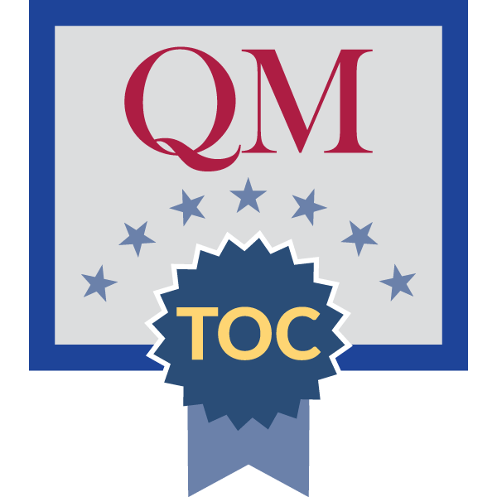
About Me
Former education journalist
Graduate student, MLIS program, University of Arizona
Teaching Information Literacy Certificate, Ohio State University
JMC 168 Media Literacy & Society
APA required in all submissions/assessments
Physical APA Publication Manual required
QM Master Reviewer (HE)

Slide 3
Session Goals
1️⃣ Explain the transferability of information literacy skills to both academic and professional skills.
2️⃣ Determine essential information literacy components for a weeklong focus, regardless of the discipline.
3️⃣ Guided by the Quality Matters Rubric, plan activities and assessments to help students practice and strengthen core information literacy skills.

Slide 4
What information literacy integrations do you
practice in your courses or design for instruction?
Mentimeter Poll

Slide 5
Information Literacy Definitions
1
2
3
"the ability to locate, evaluate, and use information to become independent life-long learners” (Commission on Colleges, Southern Association of Colleges and Schools, Criteria for Accreditation, Section 5.1.2 [Library and Other Information Resources] Services . 10th ed. Dec. 1996)
“ … set of integrated abilities encompassing the reflective discovery of information, the understanding of how information is produced and valued, and the use of information in creating new knowledge and participating ethically in communities of learning" (ACRL Framework for Information Literacy for Higher Education, 2015)
"To be information literate, a person must be able to recognize when information is needed and have the ability to locate, evaluate, and use effectively the needed information" (American Library Association Presidential Committee on Information Literacy, Final Report, 1989)

Slide 6
Library instruction often features one-shot sessions in which librarians interact briefly with students or include online library modules (McCartin, Evers, & Markowski, 2019).

Slide 7

Why devote time to information literacy, references, citations — all things libraries?
Use information for decision making.

Slide 8
Save you time in the end

Slide 9
Enhance students’ skills
Teaching students how to use style manuals can help to encourage greater transparency in their work (Liles & Rozalski, 2004).

Slide 10
Students Today — and Tomorrow
Research Skills
Professional Skills

Slide 11
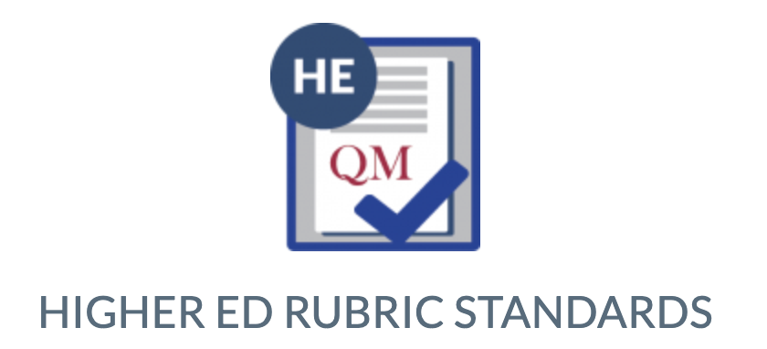

Standard 1: Course Overview & Introduction
Standard 2: Learning Objectives (Competencies)
Standard 3: Assessment and Measurement
Standard 4: Instructional Materials
Standard 5: Learning Activities & Learner Interaction
Standard 6: Course Technology
Standard 7: Learner Support
Standard 8: Accessibility and Usability

Slide 12
Reference Building Challenge
Objective: Format raw bibliographic data into proper references.
Materials:
Post-It Notes
List of raw bibliographic data for various source types.
Style guides or online reference generators.
Steps:
Ask students what information they use or value to help them or others find something (e.g., song).
Give students Post-It Notes, providing 15 minutes for them to identify the data, then format into references.
Discuss common formatting rules and errors as a class.
Assessment: Students submit their formatted references for grading, or you can award discussion participation points.

Slide 13
Reference Scavenger Hunt
Objective: Identify and correct errors in references.
Materials:
A handout with incorrectly formatted references.
Style guides or online access to generation tools.
Steps:
Divide students into pairs, and distribute different handouts with errors.
Instruct students to correct the references using the APA style guide on their own first.
After 10 minutes, tell the students to trade worksheets and check the work.
After 20 minutes, review corrections as a class, discussing why changes were necessary.
Assessment: Students submit corrected references for evaluation based on accuracy and consistency.

Slide 14
Source Evaluation Workshop
Objective: Evaluate the credibility and relevance of sources.
Materials:
A mix of sources (scholarly articles, news articles, blogs, etc.).
Evaluation criteria handout or slide.
Steps:
Introduce criteria for evaluating sources (e.g., author’s credentials, publication date, bias).
Divide students into small groups and assign each group a set of sources.
Ask groups to evaluate each source based on the criteria.
Groups present their findings.
Assessment: Students write a short analysis of one source, justifying their evaluation.

Slide 15
Source Evaluation
Criteria for evaluating sources:
Author’s credentials
Publication date
Kind of item published (scholarly article, news article, blog post, government report, opinion column)
Location of the item in the publication
Publication
Bias

Slide 16
Source Evaluation
Brown, J. (2022). Impact of climate change on agriculture. Journal of Environmental Studies, 15(2), 45-67.
Smith, R. (2023). Farmers struggle with drought conditions. The Daily Gazette.
Davis, L. (2021). My thoughts on climate change and farming. Personal Blog.
U.S. Department of Agriculture. (2020). Annual report on climate and farming trends.
Thompson, A. (2022). Why climate change is questioned. Opinion Weekly.

Slide 17
Advanced Search Simulation
Objective: Use advanced search techniques to find reliable sources.
Materials:
Computers with internet access.
Access to library databases.
A research question or topic for practice.
Steps:
Demonstrate advanced search techniques (e.g., Boolean operators, keywords, filters).
Assign a research question to each student or a pair of students.
Allow students 30 minutes to find three credible sources.
Discuss their findings and techniques used.
Assessment: Students submit a list of sources with proper references and a brief explanation of their search strategy.

Slide 18
Advanced Search Simulation
Boolean operators
Keywords
Filters
Thesis statement for practice:
Using Agenda-Setting Theory, Cultivation Theory, and Uses and Gratifications Theory, this research paper explores how mass media influences public perception, emphasizing the need for media literacy education.
How could we find three credible sources?

Slide 19
Paraphrasing & In-text Citations
Objective: Practice paraphrasing and citing sources within writing.
Materials:
Excerpts from academic articles.
Writing materials or computers.
Steps:
Explain the importance of paraphrasing and proper citation.
Provide each student with an excerpt to paraphrase.
Instruct students to include an in-text citation.
Review and discuss examples as a class.
Assessment: Discussion prompt in Canvas for students to evaluate paraphrasing for accuracy and proper use of in-text citations.

Slide 20
Paraphrasing & In-text Citations
If you re-write a sentence or a paragraph from a source into your own words, you must (1) cite the source in the text and (2) include the full reference at the end of the paper.
2 kinds of in-text citations:
Parenthetical — (Shemberger, 2025)
Narrative — Shemberger (2025) reported that …

Slide 21
Paraphrasing & In-text Citations
Do not lift material by quoting an entire sentence or paragraph!
The citation and full reference must match!

Slide 22
Paraphrasing & In-text Citations
With the rise of digital media, individuals are exposed to an unprecedented volume of information daily. The ability to critically assess the credibility of sources is essential in navigating this information landscape. Studies suggest that people who possess higher levels of media literacy are better equipped to distinguish between reliable journalism and misinformation. Furthermore, the role of cognitive biases in shaping how audiences interpret news underscores the importance of teaching critical thinking skills alongside media literacy education.
Smith, T., & Johnson, M. (2020). The effects of social media. Communication & Society, 3(2), 45-56.

Slide 23
Paraphrasing & In-text Citations
Paraphrased excerpt with parenthetical citation:
Media literacy education can contribute to improved cognitive skills that would help people to tell the difference between credible journalism with little bias and misinformation (Smith & Johnson, 2020).
Reference
Smith, T., & Johnson, M. (2020). The effects of social media. Communication & Society, 3(2), 45-56.

Slide 24
Paraphrasing & In-text Citations
Paraphrased excerpt with narrative citation:
Smith and Johnson (2020) concluded that media literacy education can contribute to improved cognitive skills that would help people to tell the difference between credible journalism with little bias and misinformation.
Reference
Smith, T., & Johnson, M. (2020). The effects of social media. Communication & Society, 3(2), 45-56.

Slide 25
Live Citation Lab
Objective: Apply real-time feedback on their citations.
Materials:
Students’ current projects or assignments.
Access to style guides or citation tools.
Steps:
Set up a live feedback session in class.
Invite students to bring their reference lists or individual citations.
Provide immediate feedback and suggest corrections.
Assessment: Students submit their revised citations.

Slide 26
What activities might you choose?
Visit the Library — and Your Librarian
Reference Building Challenge
Reference Scavenger Hunt
Source Evaluation Workshop
Advanced Search Simulation
Paraphrasing & In-text Citations
Live Citation Lab
Other ideas?

Slide 27
References
Liles, J. A., & Rozalski, M. E. (2004). It’s a matter of style: A style manual workshop for preventing plagiarism. College & Undergraduate Libraries, 11(2), 91–101. https://doi.org/10.1300/J106v11n02_08
McCartin, L. F., Evers, S., & Markowski, B. (2019). Student perceptions of information literacy skills and curriculum before and after completing a research assignment. The Journal of Academic Librarianship, 45(3), 262–267. https://doi.org/10.1016/j.acalib.2019.03.009

Slide 28
Thank You
Melony Shemberger, Ed.D.
mshemberger@murraystate.edu

