Slide 1
Crafting Engaging Learner Experiences through Integrated Support and Collaboration
Dionne Thorne, PhD
Assistant Dean, Curriculum and Operations
Morgan State University

Slide 2
“Impact Through Quality Connections”
“Impact Through Quality Connections”
November 3 – 5, 2025
Tucson, Arizona
November 3 – 5, 2025
Tucson, Arizona

Slide 3
Objectives
Identify at least two methods for integrating feedback from students, faculty, and support services into course redesign for continuous improvement.
Create a standardized online course template that enhances learner engagement and incorporates key QM Standards.

Slide 4

Transformation Morgan 2030
Launch the Morgan Completes You Initiative with ambitious enrollment and degree completion goals

Slide 5
18 interdisciplinary degree programs designed for degree completion
Bachelor of Science (BS) | Master of Science (MS) | Doctor of Philosophy (PhD)
Educational Studies Engineering, Information, and Computational Sciences Global Perspectives and Practices Health and Human Sciences Organizational Administration Technology Services Sciences Societal Equity, and Urbanism | Engineering, Information, and Computational Sciences Health and Human Sciences Journalism and Mass Communication Organizational Policy, Governance & Administration Sciences | Engineering, Information, and Computational Sciences Health and Human Sciences Journalism and Mass Communication Organizational Policy, Governance & Administration Sciences
Notes:
Our top undergraduate majors are Health and Human Sciences and Organizational Administration; Our top Masters degree is Organizational, Policy, Governance and Administration; It is also our top doctoral program.

Slide 6



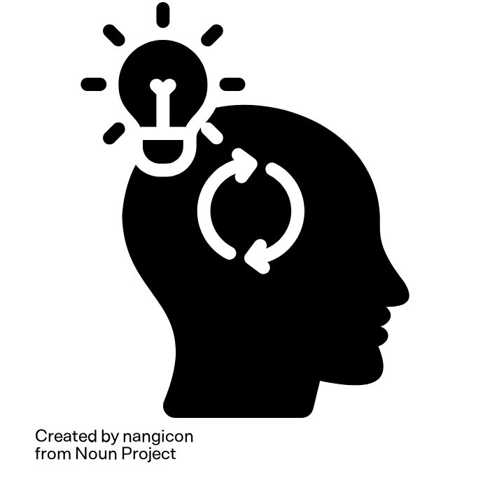
L | O | V | E
Lifelong learning and Legacy – We meet students where they are and believe that it is never too late to finish what you started and create a legacy for the next generation. | Opportunity and Optimism – Every student can complete a degree and meet their personal and professional goals. | Vision and Value – We recognize importance of each student's vision for the future and support them academically to achieve that vision. We work to make our degrees add value both personally and professionally. | Engage, Excel, and Evolve – Our team works with every student to engage, excel and grow as a learner so that they can achieve their dreams.
Notes:
This principle has guided us to go above and beyond for students and to continue to advocate for tools, resources, and changes needed to give our students what they need to achieve their personal, academic, and professional goals

Slide 7
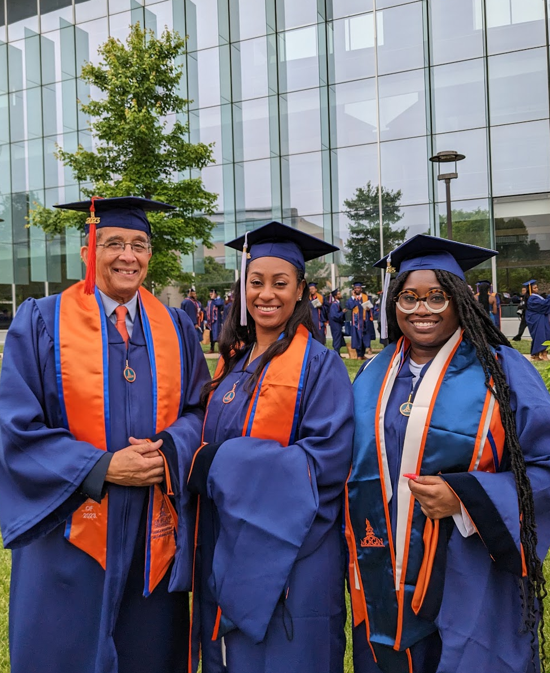
MCY Students
94 Graduates since January 2022: 2 PhD, 12 Masters (100% completion rate), and 80 undergraduates
Average age of a Morgan Completes You student is 43 years
Legacy Scholars, Degree Completers, Career Changers, and Paper-Ceiling/Promotion Seekers

Slide 8

Feedback
Survey/Focus Group/Team Meetings
Dean's Office
Student Support Team
Student Workers
Adjunct Faculty
Notes:
Two approaches to secure feedback
Tight timeline April-August
CICS is a small academic unit-Dean’s Office; Student Success, Communication & Marketing and Admissions, Enrollment and Partnerships
Some of our staff also teach
No ID

Slide 9

Quality Matters
General Standard 1
General Standard 5
General Standard 7
General Standard 8
Notes:
What standards could have the greatest impact on our students
GS 1: 1.1; 1.2; 1.3;1.6; 1.7; 1.8 & 1.9
GS 5: 5.3; 5.4;
GS 7 : 7.1; 7.3; 7.4
GS 8: 8.1; 8.2

Slide 10
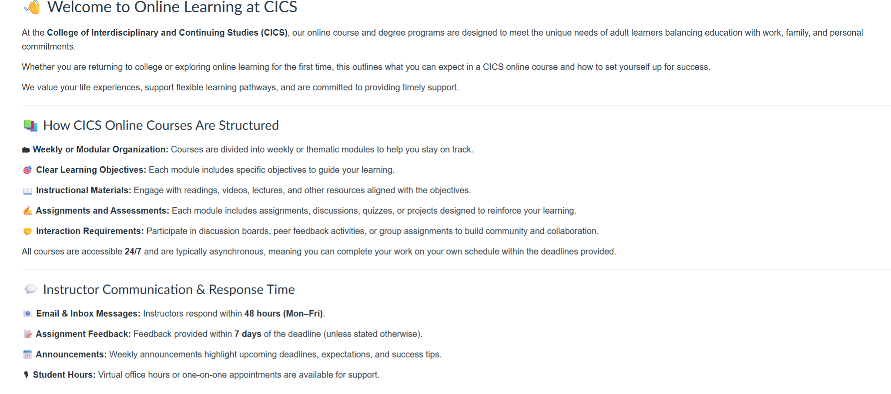
CICS Online Learning Overview

Slide 11
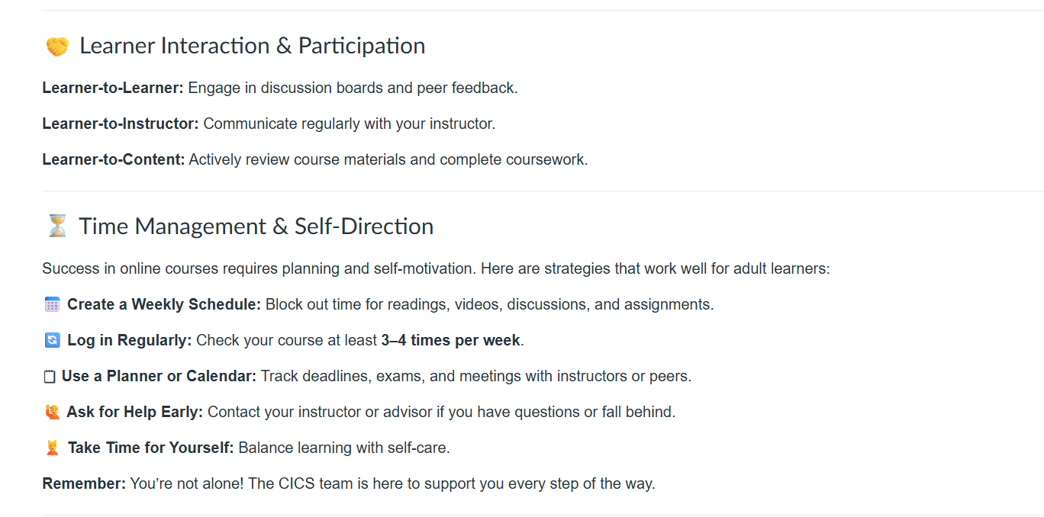
CICS Online Learning Overview

Slide 12
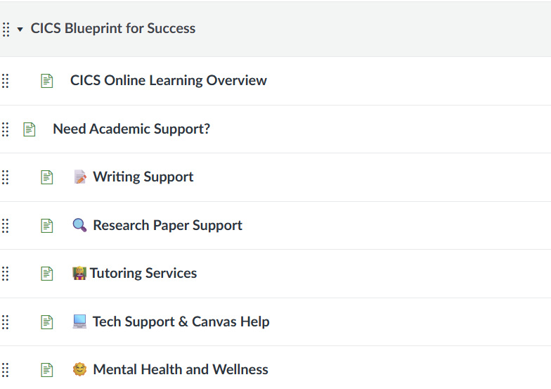
CICS Template
Notes:
We recently added a Wellness

Slide 13
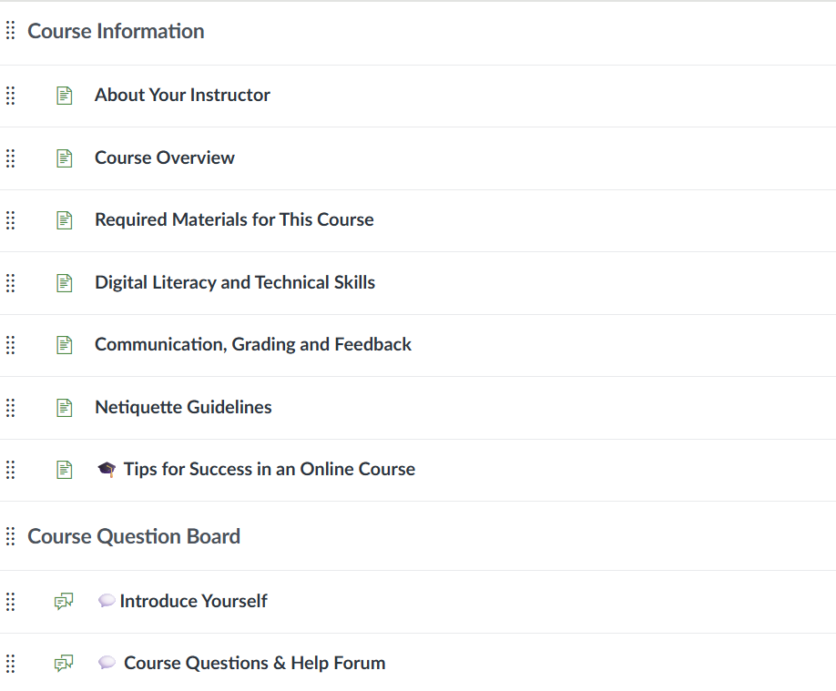
CICS Online Template

Slide 14
Next Steps
CICS Accessible Syllabus Template
CICS Adjunct Orientation

Slide 15
Questions

