Slide 1
Transitioning to an Open Educational Resource for a Master Core Course (Management Principles & Concepts) QM East Regional Conference 4/24/20
Sheri Schulte, sbs@uakron.edu
Associate Professor of Practice, Department of Management
College of Business Administration
The University of Akron

Slide 2
Transition to an Open Resource: Our Project Plan
SPRING 2017
1. Task: TAG, Text, Align
2. Textbook Review
3. Committee
FALL 2017
1. Course Design
2. Tag Alignment
3. Finalize Content/ Sequence
SPR/SUM 2018
1. Developed materials: slides, test bank, exercises
2. TAG submission
FALL 2018
1. Implement new design
2. Collaboration
3. Continuous improvement
4.TAG approval
SPRING 2019
1. Online Master Course
2. Continuous improvement
3. New Mod-Communications
FALL 2019/SPR 20
1. Continuous Improvement
2. Prepare for QM Review
3. New Mod-Ethics

Slide 3
BEST PRACTICES
BENEFITS
Smooth Transition
Alignment
Continuous Improvement
Access Day 1
Student Engagement
Collaboration
Point Person / Shared Drive
Affordable Learning Grant
Use the book
Get Ready for QM

Slide 4
Survey on Textbook Costs 12/3/17
Coping with the cost | Answer is yes
1. Purchase an older edition of the textbook | 23 | 82.14%
2. delay purchasing textbook | 26 | 92.86%
3. never purchase textbook | 22 | 78.57%
4. share textbook with other students | 19 | 67.86%
5. download textbook from internet | 17 | 60.71%
Has the cost of … caused you to:
6. not purchase required textbook | 24 | 85.71%
7. take fewer courses | 8 | 28.57%
8. not register for a specific course | 5 | 17.86%
9. earn a poor grade | 10 | 35.71%
10. drop a course | 7 | 25.00%
11. fail a course | 3 | 10.71%
Total number of students | 28

Slide 5
EARLY ON
Potential Savings – Mgt:
634 students enrolled over Fall 2017/Spring 2018 semesters X $93.00 (average book cost) = $58,962.
If only 75% of 634 bought the book: 476 X $93.00 = $44,268 potential savings.
Add on Fall 2018 (implementation) and Spring 2019 and the savings doubles to over $117,000.
Spring 2019 - Proposal to Office of Academic Affairs for one time funds of $10,000.
Our course received $2500.00 grant. Work completed Fall 2019.
The ALI spent $9500 – awarded grants for five courses.
The five funded projects were able to save $263,497 with OER implementation.
For more information on our Affordable Learning Initiative, contact:
skaufman@uakron.edu. (Steve Kaufman, Senior Instructional Designer, Quality Matters Coordinator, Quality Matters Ohio Consortium State Lead
uakron.edu/affordablelearning

Slide 6
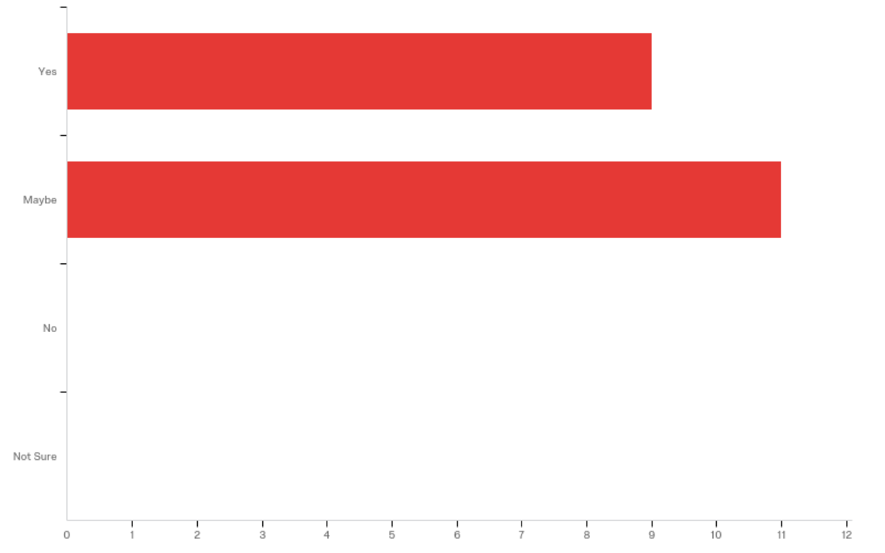
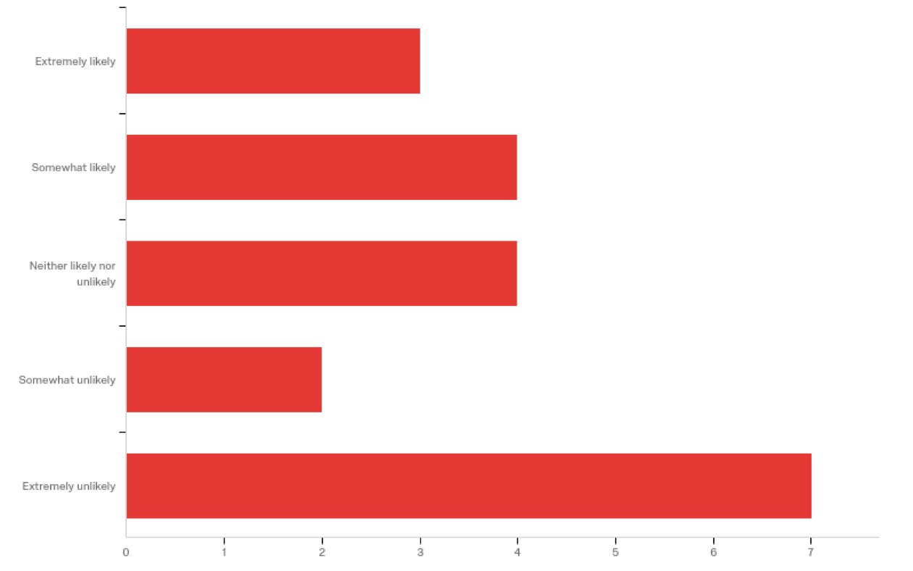
ALI Student Feedback: Management Principles & Concepts
The previous textbook for this Management Principles course was $93. Given this information, how likely would it have been that you would have purchased the textbook?
Did having an open textbook or open resources contribute to your student success in this course?
“It just feels better to have free access to something rather than stress over the big price tag of books you purchase themselves”
“This textbook was organized and the information was presented in a manner that increased my retention.”
“It took some stress away from money, so I could focus more on the actual work.”
“It is nice to have my book on the computer where I can easily search words or pages instead of flipping through a book or looking through an index”
Notes:
[Steve & Sean]

Slide 7
Thank you! Sheri Schulte sbs@uakron.edu
https://open.umn.edu/opentextbooks
https://resources.saylor.org/wwwresources/archived/site/textbooks/Business%20Communication%20for%20Success.pdf
https://openstax.org/details/books/business-ethics

