Slide 1
Course Review SNAFUs
Turning Issues into Solutions

Slide 2
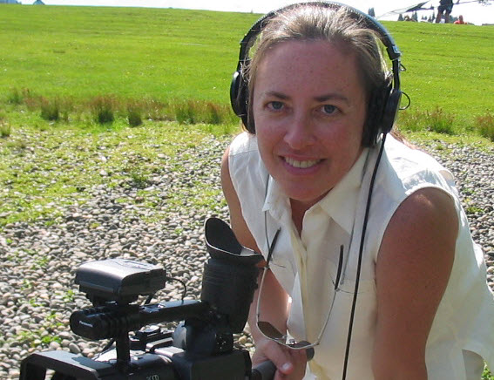
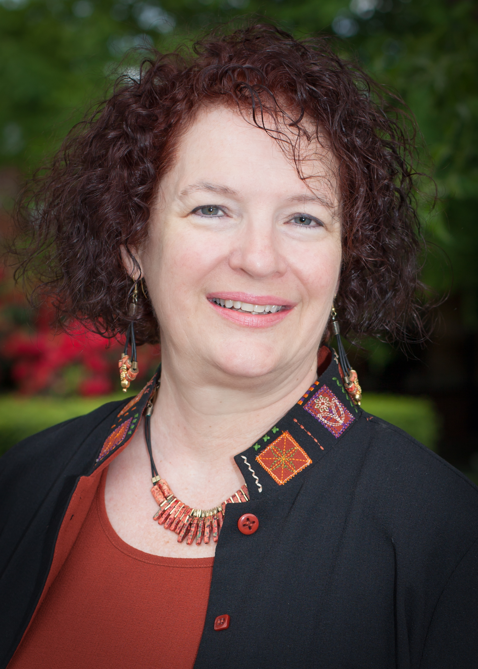
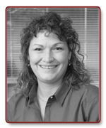
Paula Ascher
Kathy
Chatfield
Beth
Hale

Slide 3
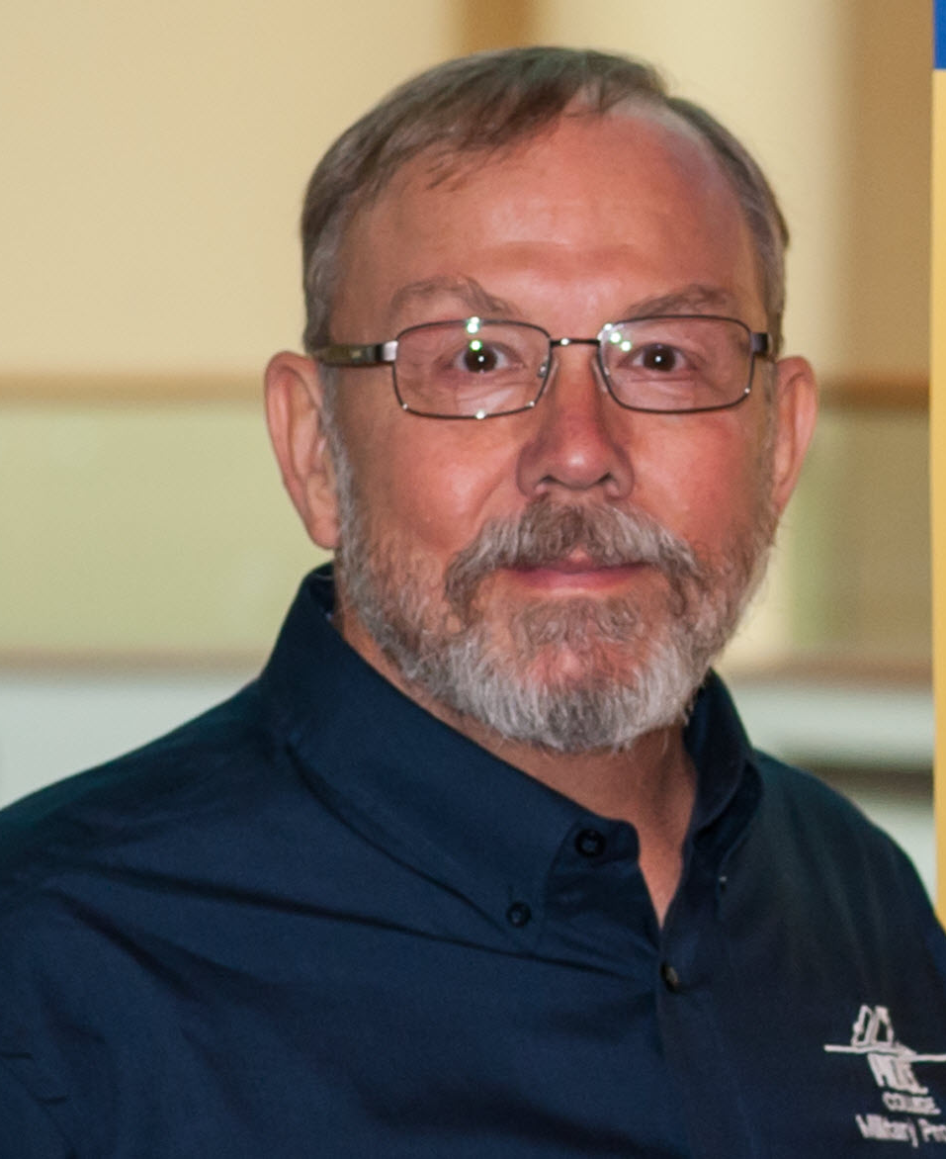
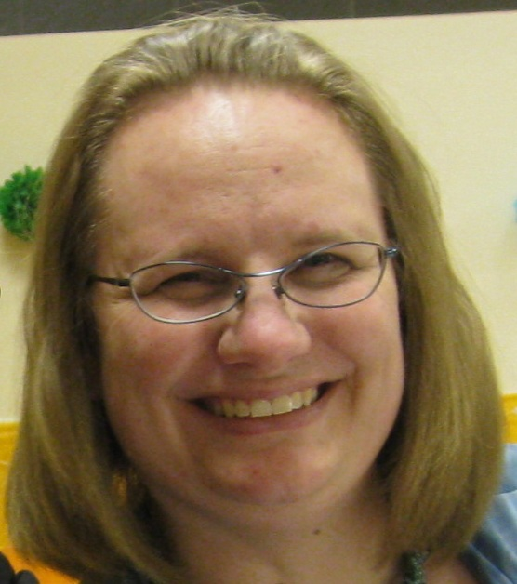
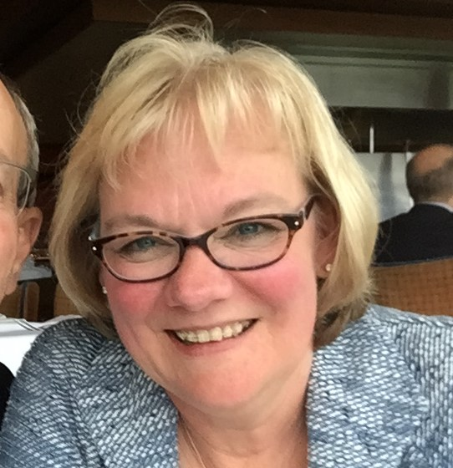
JJ Johnson
Lisa Kidder
Julie Lemmond

Slide 4
Session Objectives
Apply solutions to problems that arise during course reviews
Think creatively to prevent issues ahead of time
Connect with other QM Course Review Managers

Slide 5
Course Review SNAFUs
What? When? Where?
How did you “fix” it?

Slide 6
Ask the Panel
Did something come up in a Course Review that you'd like the panel to address?
(Hand in your cards)

Slide 7
Ask the Panel
Paula’s Course Review Handout: https://www.cgcc.edu/sites/cgcc.us/files/online/Procedure%20Manual%20-%20Quality%20Matters%20at%20CGCC3.pdf

Slide 8
Course Review SNAFUs
Turning Issues Into Solutions
Please complete your session evaluations

