Slide 1

Twelve Step Program to Meeting Quality Matters
Miley Grandjean & Sandra Johnson
New Mexico State University
Notes:
Miley

Slide 2
Agenda
Introductions
OCIP overview
Checklist 1
Sample QM course activity
Questions and comments
Thank you!
Notes:
Miley

Slide 3
Some Background on Online Course Improvement Program (OCIP) at NMSU
OCIP beginnings and support
Overview of program and expectations
Cohort I-V- completions and dropouts (1Y+);
  Cohort I (N2O)
Methods of providing support includes mentoring, workshops, open labs
Notes:
Sandy

Slide 4
Developed Checklists
Discovered that participants needed more guidance and support
Developed the 8 checklists aligned to the 8 general standards of Quality Matters
Use checklists for training, course design and revision of online learning environments
Notes:
Sandy

Slide 5
Step 1: Welcome Email (1.1)
Send a welcome email to students that contains the following-
WELCOME to your course
WHERE to find your course
HOW to access the course
WHAT to click first to get started
Notes:
Miley – this can contain any amount of information, but certainly you want to make sure it has these main components. Remember, this communication is happening outside of an LMS, so provide a link TO the LMS and instructions on how to login or who to call if they have issues logging in.

Slide 6
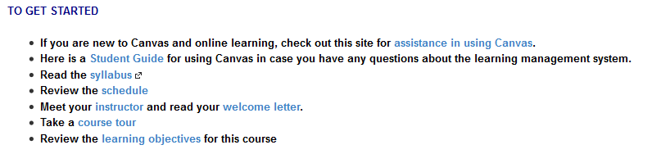
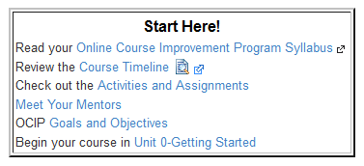
Step 2: What do students do first? (1.1)
Students have accessed their course. What do they do now? Provide specific steps on what you want them to do to get started.
Notes:
Miley – Well, because of Step 1, students were able to log in successfully – now what? Don’t overwhelm them – just give them a few things to get started with – If they are new to the LMS, perhaps they’ll need a link to a student tech group, linking to the syllabus, schedule, and maybe even introductions is good in Step 2: we want to give them enough info on how to get started while beginning to make them feel at ease.

Slide 7
Step 3: The Foundation-Your Syllabus (1.2)
    Provide access to your syllabus
      States the purpose of the course
      Explains how the content is structured and carried out
      Contains a course schedule
      Explains delivery modalities (online or blended)
      Discusses modes of communication
      Describes types of learning activities
      States how learning will be assessed
Notes:
Miley – This was probably already linked to from Step 2, but good access to the syllabus (at all times) is essential. I even include the syllabus in my welcome emails.

Slide 8
Step 4: Course Outline/Pacing Guide (1.2)
A course outline or pacing guide provides an overview of your course and should include –
    Times
    Places
    Scheduled Events
    Assignments
    Assessments
    Due Dates
Notes:
Miley – when are their drafts due versus final copies? When are you hosting a synchronous study group? What the due dates of assignments?
If a schedule is setup in a certain way, can’t it serve as a pacing guide?

Slide 9
Step 5: Netiquette (1.3)
An etiquette or "Netiquette" statement provides-
Expectations for communication
Examples of netiquette considerations:
  Expectations for the tone and civility used in communication
  Expectations for email content
  “Speaking style” requirements (abbreviations, emoticons, etc)
  Spelling and grammar expectations
  Discussion board participation
Notes:
Miley – maybe you allow them to use a more colloquial style during live-chats because it is in intended to be more like speech than writing, but expect proper grammar in emails and discussion boards.

Slide 10
Step 6: Student Resources (1.4)
Academic support
Library
Writing assistance
Math assistance
Any specific student resource required or suggested for your course
Tech Assistance
Notes:
Miley – Here’s your first chance at being able to help students understand what resources might help them be successful in your course (or their other courses).

Slide 11
Step 7: Prerequisites Needed (1.5)
Information about prerequisite knowledge (i.e., passed BIO 100, ?????)
Any required competencies (i.e., Native Spanish speaker, ACT score of 20 or above, BA in English)
Information should be found within the course in documents linked to the course
Supporting material provided to the student by another means
Notes:
Sandy

Slide 12
Step 8: Competencies & Tech Skills (1.6)
General as well as course-specific technical skills
Examples of technical skills might include
Using the learning management system
Using email with attachments
Creating and submitting files in commonly used word processing program formats
Copying and pasting
Downloading and installing software
Using spreadsheet programs
Notes:
Sandy

Slide 13
Step 9: Instructor Information (1.7)
Initial introduction should-
  Include the instructor’s name, title, field of expertise, email address, phone number, and times when the instructor is typically online or may be reached by phone.
  Create a sense of connection between the instructor and the students
  May include personal information such as hobbies, family, travel experiences, etc.
  May include a photograph
Notes:
Sandy

Slide 14
Step 10: Student Introductions (1.8)
Student introductions help to -
  Create a welcoming learning environment
  Establish community
  Open lines of communication between students and the instructor
  Instructions for the introduction should include-
  Guidance on where and how students should share their introduction
  May ask students to respond to specific questions.
  May provide an example of an introduction and/or start the process by introducing themselves
Notes:
Miley – can mark off step 9 and 10 if you provide an example of an introduction. Set the tone for a welcome learning environment by being the first one to tell a few personal and/or professional things.

Slide 15
Let’s apply what we have learned!
Here is a sample of an online course getting started page
Use your rubric and your checklist for standard 1
Identify areas of strength and improvement
Work with your neighbor!
Share what you see
Notes:
Both – encourage them to use their laptops in order to see/click/watch video – work with partners

Slide 16

Websites for Help with Best Practice
Online Course Improvement Program-NMSU (wiki)
OCIP Website
Las Positas College
Teaching Online-University of South Florida
Instructional, Communication, and Information Technology

Slide 17
Resources
Images from http://office.microsoft.com/en-us/images/
Online Course Improvement Program Resource Wiki https://ocip.pbworks.com
Quality Matters http://www.qmprogram.org/

Slide 18

Thank you for attending!
Online Course Improvement Program
New Mexico State University

